Slide 1
Inyigisho z’urufatiro z’ikinga ry’abamugaye
Kubajejwe kudufasha kuzitanga
Inyigisho zifasha uwuri kure & Uwuhari ubwiwe.
Itariki: ….
FY20
V2-062419

Slide 2

Kaze ku nyigisho z’urufatiro zerekeye ikinga ry’abafise ubumuga zateguwe n’ikigo FWM!
Umwigisha ajejwe akarere ka Amerika yo hagati: Ilse Caballeros, OT/PT, MAEF
Ikigo ca Free Wheelchair Mission
icaballeros@freewheelchairmission.org
Akorera mu gihugu ca Guatemala
Uwukurikirana gahunda z’ukuvurwa :
Crystal Jackson, MPH
Ikigo ca Free Wheelchair Mission
cjackson@freewheelchairmission.org
Akorera mu ntara ya California
Uwujejwe gahunda z’ukuvurwa :
Nicole VanderZouwen, MS, OTR/L, ATP
Ikigo ca Free Wheelchair Mission
nvanderzouwen@freewheelchairmission.org
Akorera mu ntara ya California
Ico bajejwe
Amazina n’impamyabushobozi z’uwo murwi
Ikigo bakoramwo
Ukwo babaronka
Aho bakorera

Slide 3
Kwegereza(zumu)

Slide 4
Urutonde
Umusi/Umwanya | Ivyo kwiga/Ibikorwa
 | 1.1: Intangamarara
 | 1.2: Ukwo bigenda
 | Akaruhuko (Hagati y’iminota 5 na 10)
 | 1.3: Ubumuga & Ukwo umubiri umerewe
 | Akaruhuko
 | 1.4: Ugukwiza ibipimo neza
 | Akaruhuko (Hagati y’iminota 5 na 10)
 | 1.5: Inyigisho z’abayikoresha
 | 1.6: Gukurikirana

Slide 5
Intumbero
Kubona n’ukwegeranya igikenewe cose mu gukora ikinga kanaka
Gusubiramwo neza ivyitezwe n’abafashanya n’ikigo FWM nivyo basaba bitoburamwo.
Kugumiza hagufi ibidufasha kwibuka

Slide 6
1.1 Intangamarara

Slide 7
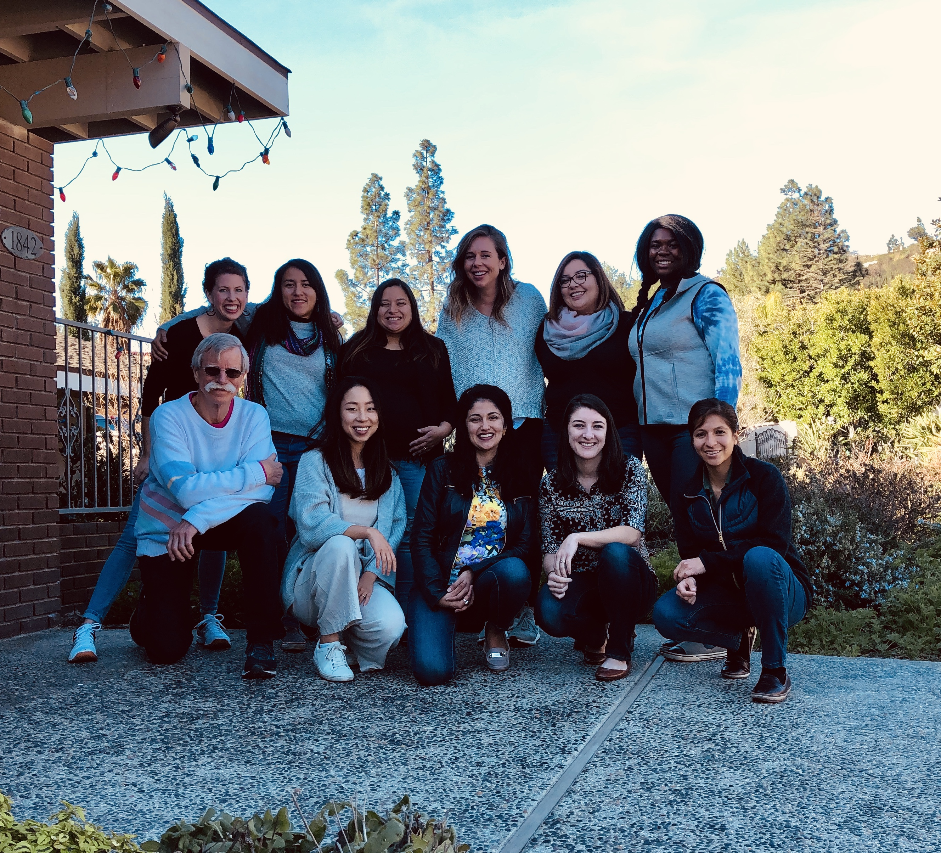
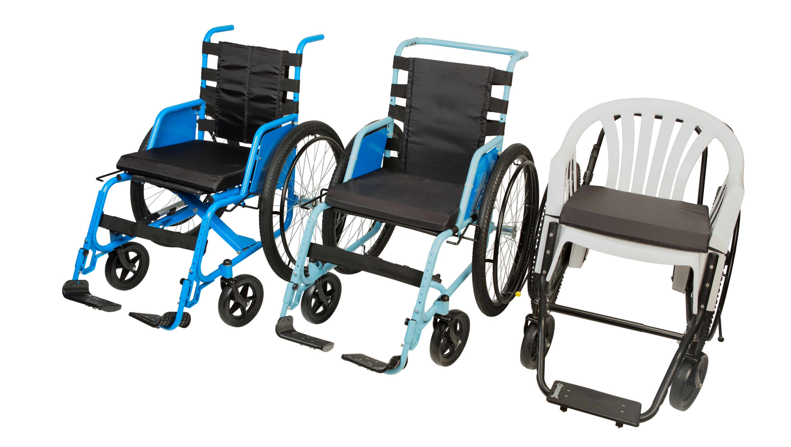
Intangamarara: Ikigo ca Free Wheelchair Mission (FWM)

Slide 8
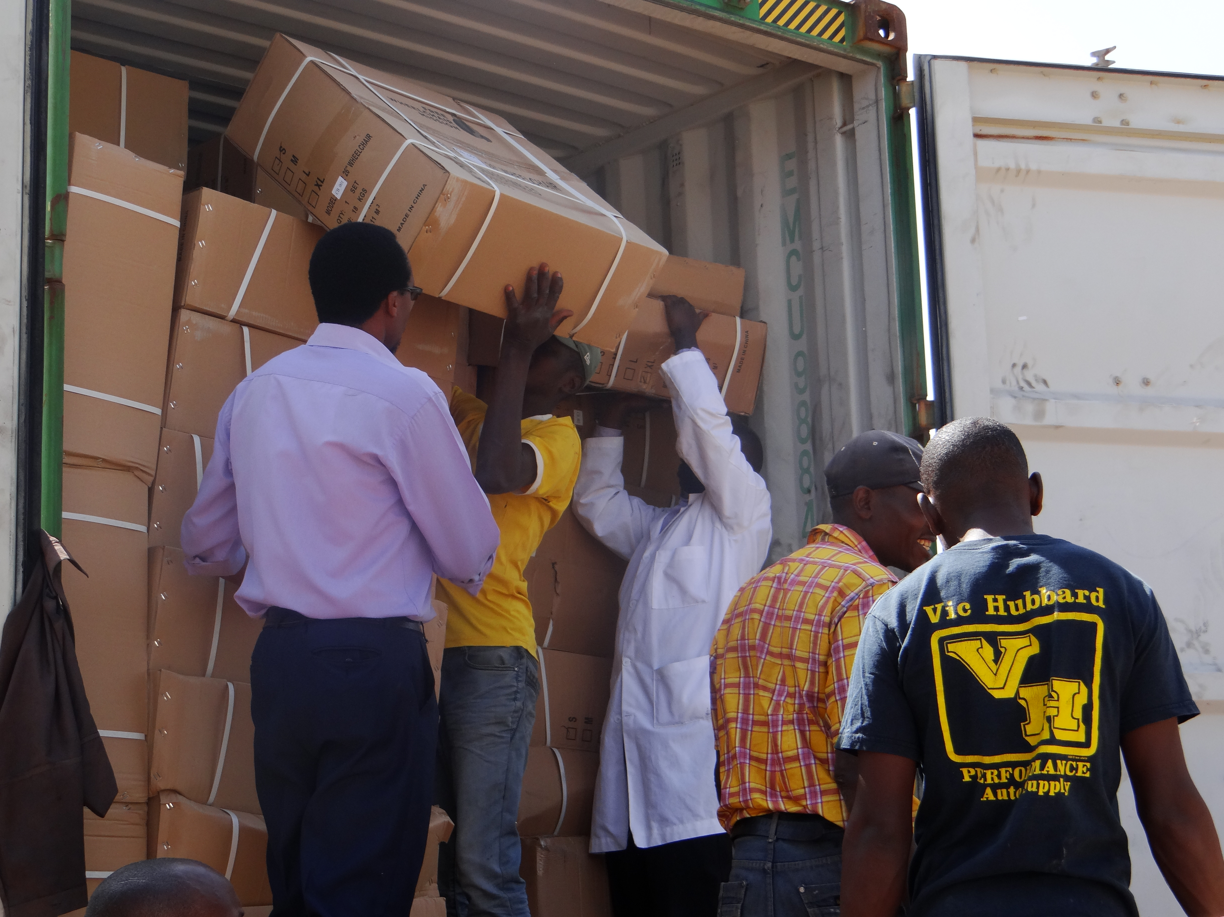
Intangamarara: Ukwo dutekera muri contineri
Ukwo contineri ingana:
  Imetero hafi 13
Ubwoko bw’amakinga butekeyemwo:
  Buracanze bivanye nivyasabwe
Ukwo amakinga atekewemwo angana:
  Hayati ya 440 na 550
Indimi zihari ku gatobo k’ubufasha:
  Urinda gusaba ururimi ushaka
Ivyuma vy’ugusubiriza:
  Ivy’uwaguze asavye

Slide 9
Intangamarara: Amakinga y’abamugaye dufise

Slide 10



Intangamarara: Ivyo tugenderako
Twama tubanza gusuzuma neza Abadushorera (Abiyandikishije/Igipapuro co kwa muganga kibigaragaza)
Guteranya ibice vyose no gufunga neza ku bantu bose.
Ntitwigera dutanga ibihimba bidafatanije.
Kuronka icemezo co kwa muganga yuko umurwayi afise ibikomere vyo kuryamira uruhande rumwe.
Ikinga ritangwa igihe rishobora kuruhura umubiri w’uwarisavye.
Ntitwigera dusaba amafaranga uwudutumbereye
Twama twagize udutabo twigisha ukwo bikora.

Slide 11
Intangamarara: Ibidufasha
Ibidufasha
Agatabo ndangabikorwa
Power
Point
Agatabo kibanze
Ireresi zo kuri Youtube
Agatabo gafasha nyene kurikoresha
Agatabo k’ubufasha mu guteranya ibihimba
Ivyapa bito bito
Akarorero kubuhinga bwo kubika munyabwonko
Urubuga
Ivyirwa wigira ku murongo
Facebook

Slide 12
Intangamarara: Ivyo igihugu kimwe kimwe cisangije
Bitegerezwa kuba biri mu gihugu kandi bikemezwa nanje ☺

Slide 13
1.2 Ukuzitanga/ Ukwegeranya ibikenewe

Slide 14

Agatabo ndangabikorwa
Ugusaba
Aho wuzuza ibipimo
Urutonde ntabanduka rwo gusuzuma
Urutonde rwemewe rw’ibipimo
Urutonde rw’inyigisho n’ugusuzuma

Slide 15
Mu ntango
Kubaza & Gusuzuma
#1
Gusubiramwo neza ivy’abasavye
#2
Gusuzuma ubwanyuma
#3
Gupanga gahunda
#4
Gusubiramwo inyigisho
#5

Slide 16
Mu kiringo co hagati
Ugusaba
Kwuzuza ibipimo
Urutonde ntabanduka rwo gusuzuma
Urutonde rwemewe rw’ibipimo
Urutonde rw’inyigisho n’ugusuzuma
Igipapuro ca muganga/ Guteranya
Ukubaza
Gufatanya neza

Slide 17
Mu mpera
Gushira ku gihe ubuhinga bwo kubika mu nyabwonko
Ivyemezo
Icegeranyo c’I conteneri
Icegeranyo c’ugusuzuma ubukomezi
Gukurikirana

Slide 18
1.3 Ubumuga & Ukwo umubiri umerewe

Slide 19
Insiguro & Ico bivako
“Abantu bafise ubumuga hamwe n’abamye bafise ingorane ku mubiri, mu mutwe, mu bumenyi canke kwiyumvamwo bivanze n’izindi ngorane zitandukanye bishobora gutuma batagira uruhara k’urugezo rumwe n’abandi mu gutanga ivyiyumviro mu kibano.”
Twisunze: UN General Assembly, Convention on the Rights of Persons with Disabilities
N’izihe mvo nyamukuru z’ubumuga
  Ukubuvukana
  Ingwara canke ukwandura
  Igikomere
  Ibidukikije

Slide 20
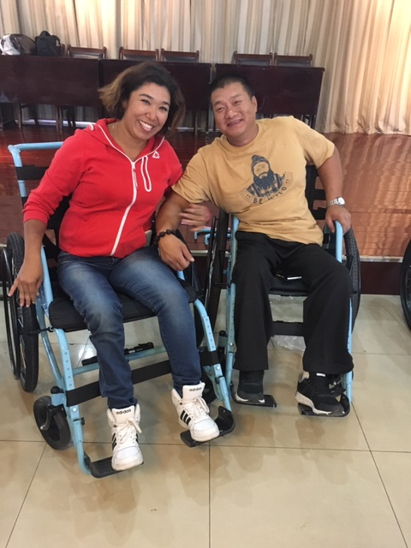
Ivyo guhimiriza ku bumuga & Imvugo yo gukoresha
Ufate umuntu nkuko nawe wipfuza ko bagufata:
  Imbere yugufasha nubaze
  Sigura ivyo uriko uragira
  Banza uvugane nuwuri kw’ikinga ry’abamugaye
  Koresha imvugo y’urupfasoni
  Kubabwira iyindi gahunda ikigo cacu kiriko kirakora batazi

Slide 21
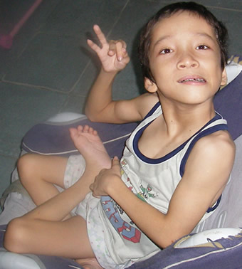
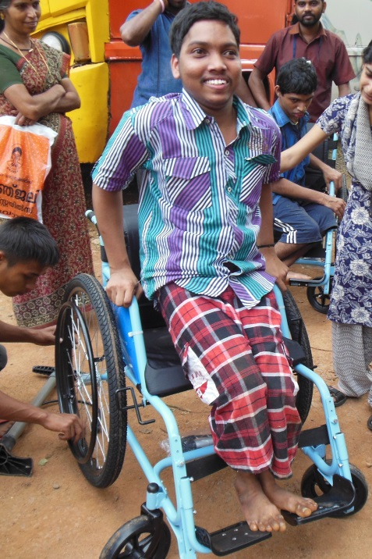
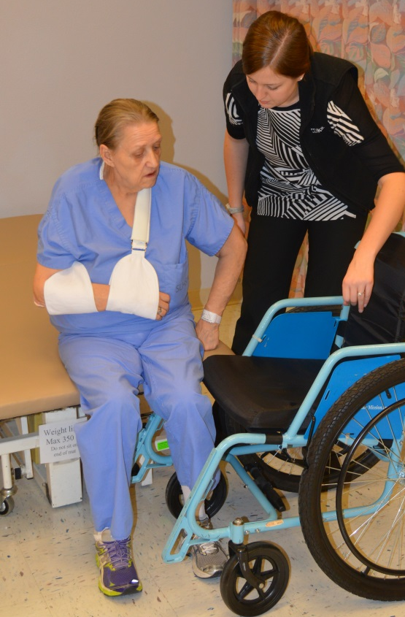
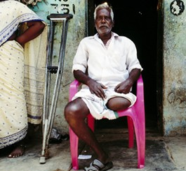
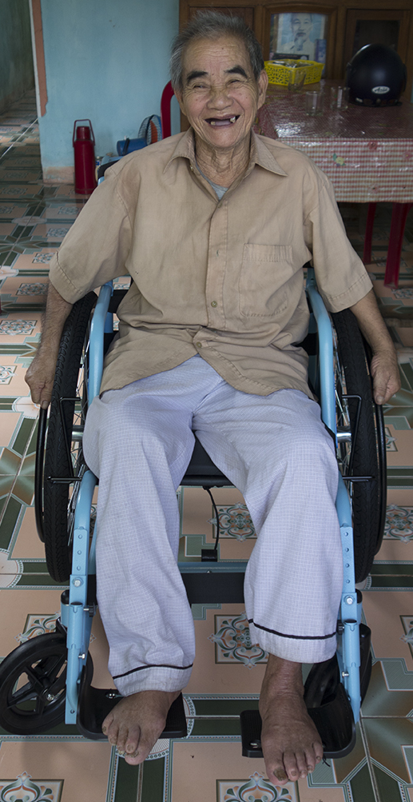
Ibimenyetso bigaragaza ingwara & amashusho

Slide 22
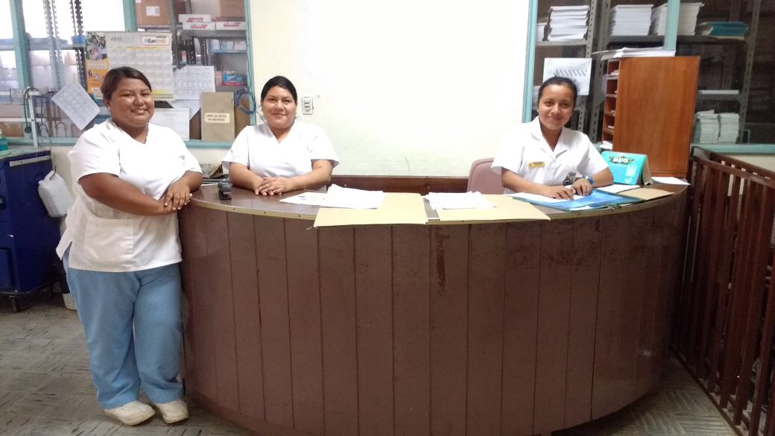
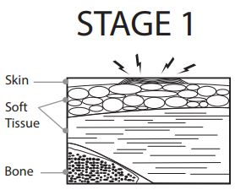
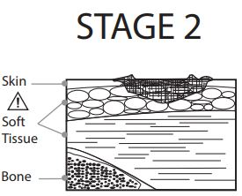
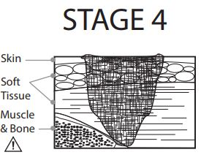
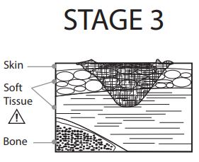
Ibikomere biva ku kuryamira uruhande rumwe
Ivyo bikomere bisigura iki?
  Ivyo bikomere ni ibiva mu kuryamira uruhande rumwe, bikanaterwa n’ukuguma umuntu yiyagaza canke umuntu kuba yaracitse igihimba c’umubiri.
N’ukwitura muganga abijejwe iyo uwawe agize mwene ivyo bikomere.

Slide 23
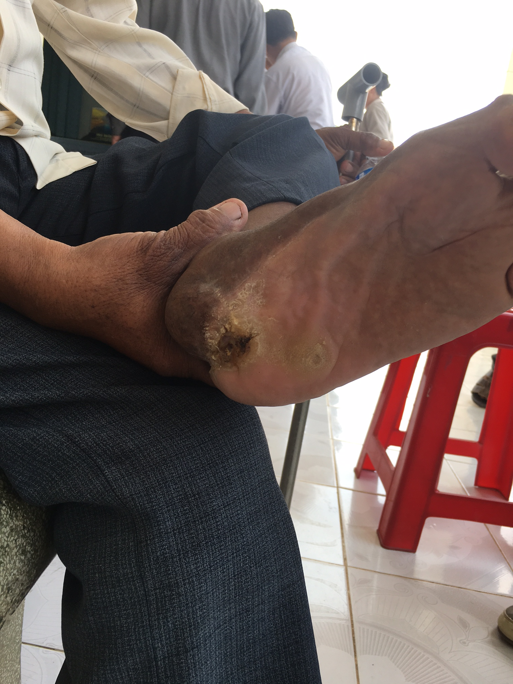
Ibikomere biva ku kuryamira uruhande rumwe (ibikurikira)
Ibihimba vy’umubiri abantu benshi bakunda kugirira ivyo bikomere.

Slide 24
1.4 Ugukwiza neza ibipimo
Kubaza, Igipapuro co kwa muganga, Guteranya, Gufatanya neza

Slide 25
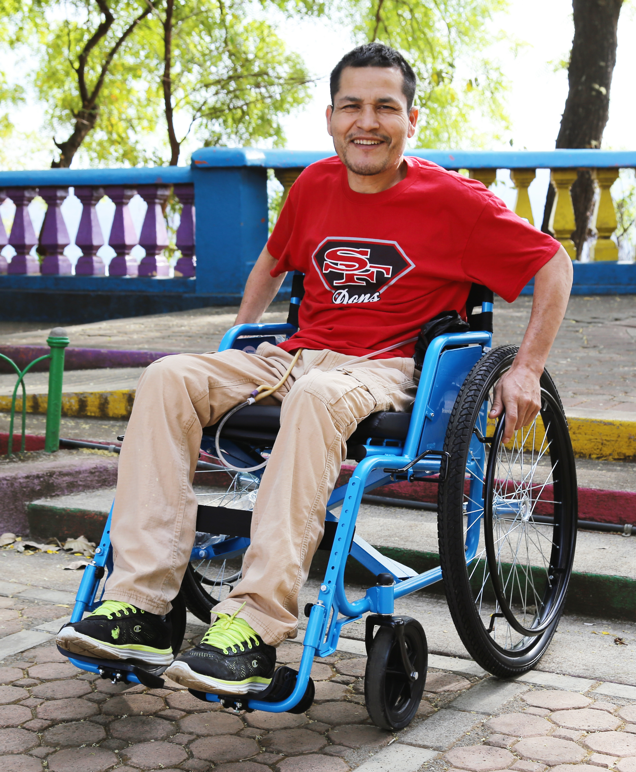
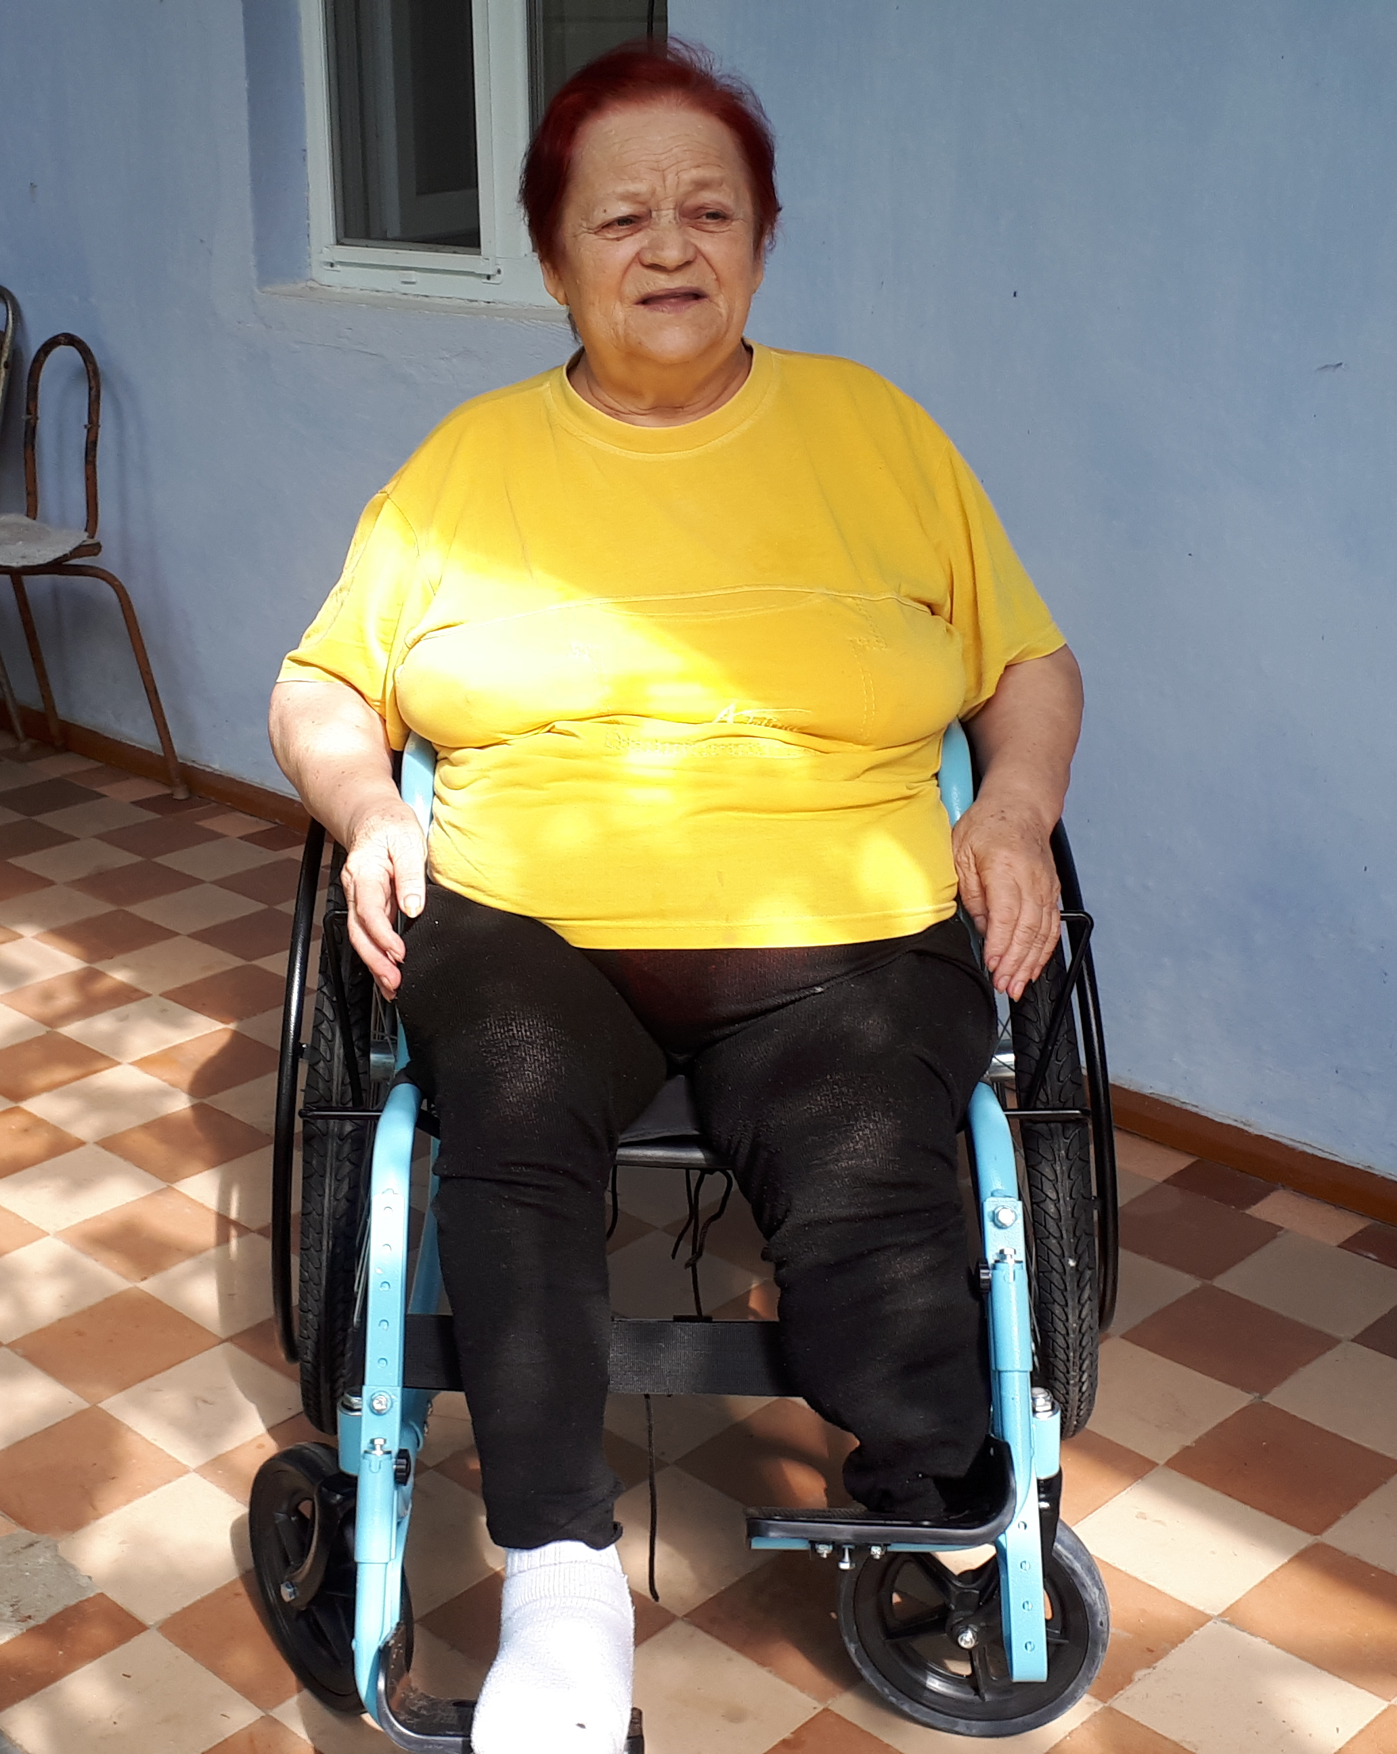
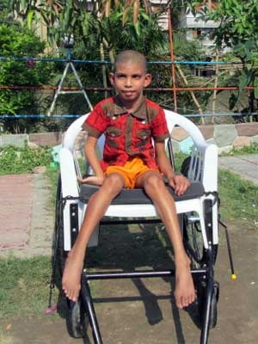
Ibipimo muri rusangi
NI RITO CANE
NI RININI CANE
RIRAMUKWIYE NEZA

Slide 26
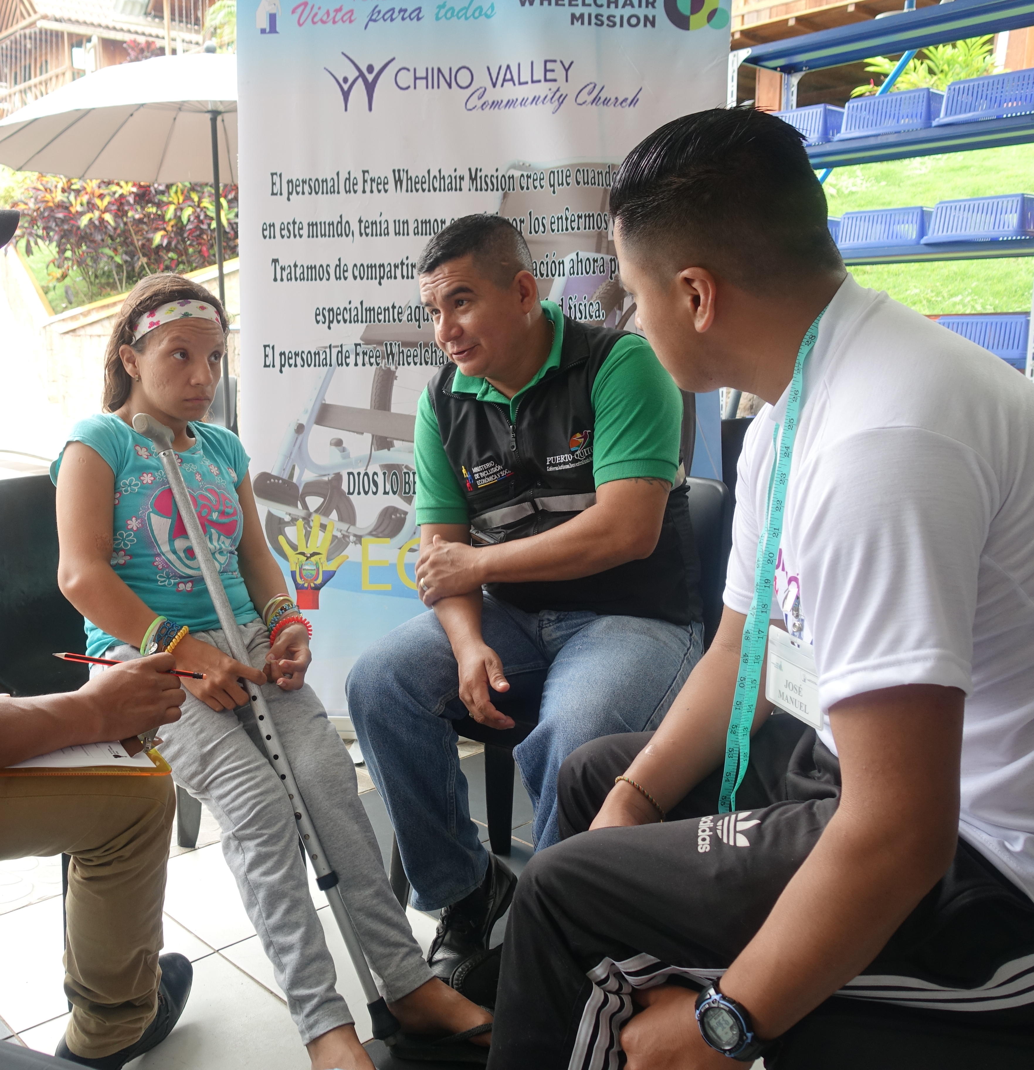

Ukwo ibibazo bitunganywa
Gutunganya neza aho mwicara
Kugerageza kumenya uwo wakiriye

Slide 27
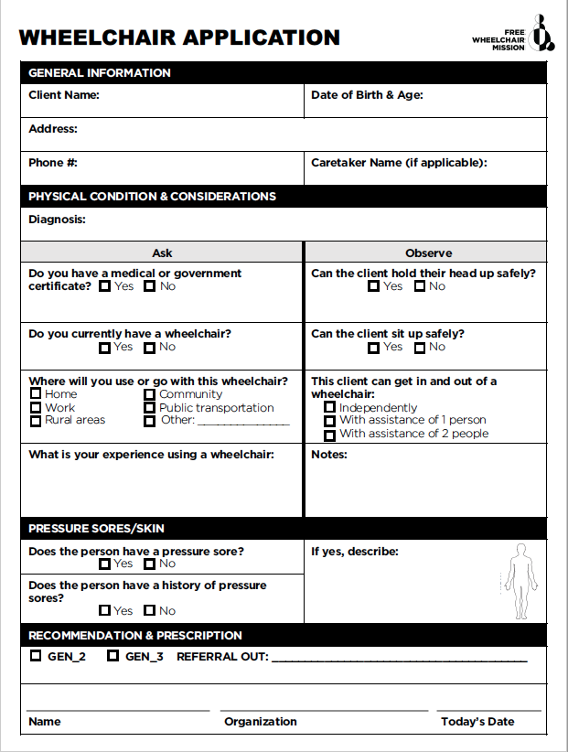
Ibibazo: Abasavye
Abasavye
  Ibibazo vyo kubabaza
    Ivyo kumenya muri rusangi
    Ibikomere vyo kuryama uruhande rumwe/Ukwo umubiri umerewe
    Ibimenyetso biranga ingwara
    Ukumenyera
  Ubukerebutsi bwo kuraba neza
    Kuva kw’ikinga uja ahandi
    Ukwo agenda
    Ubushobozi bwo kwicara ugororotse
  Ibisabwa

Slide 28
Ibibazo: Ibipimo

Slide 29
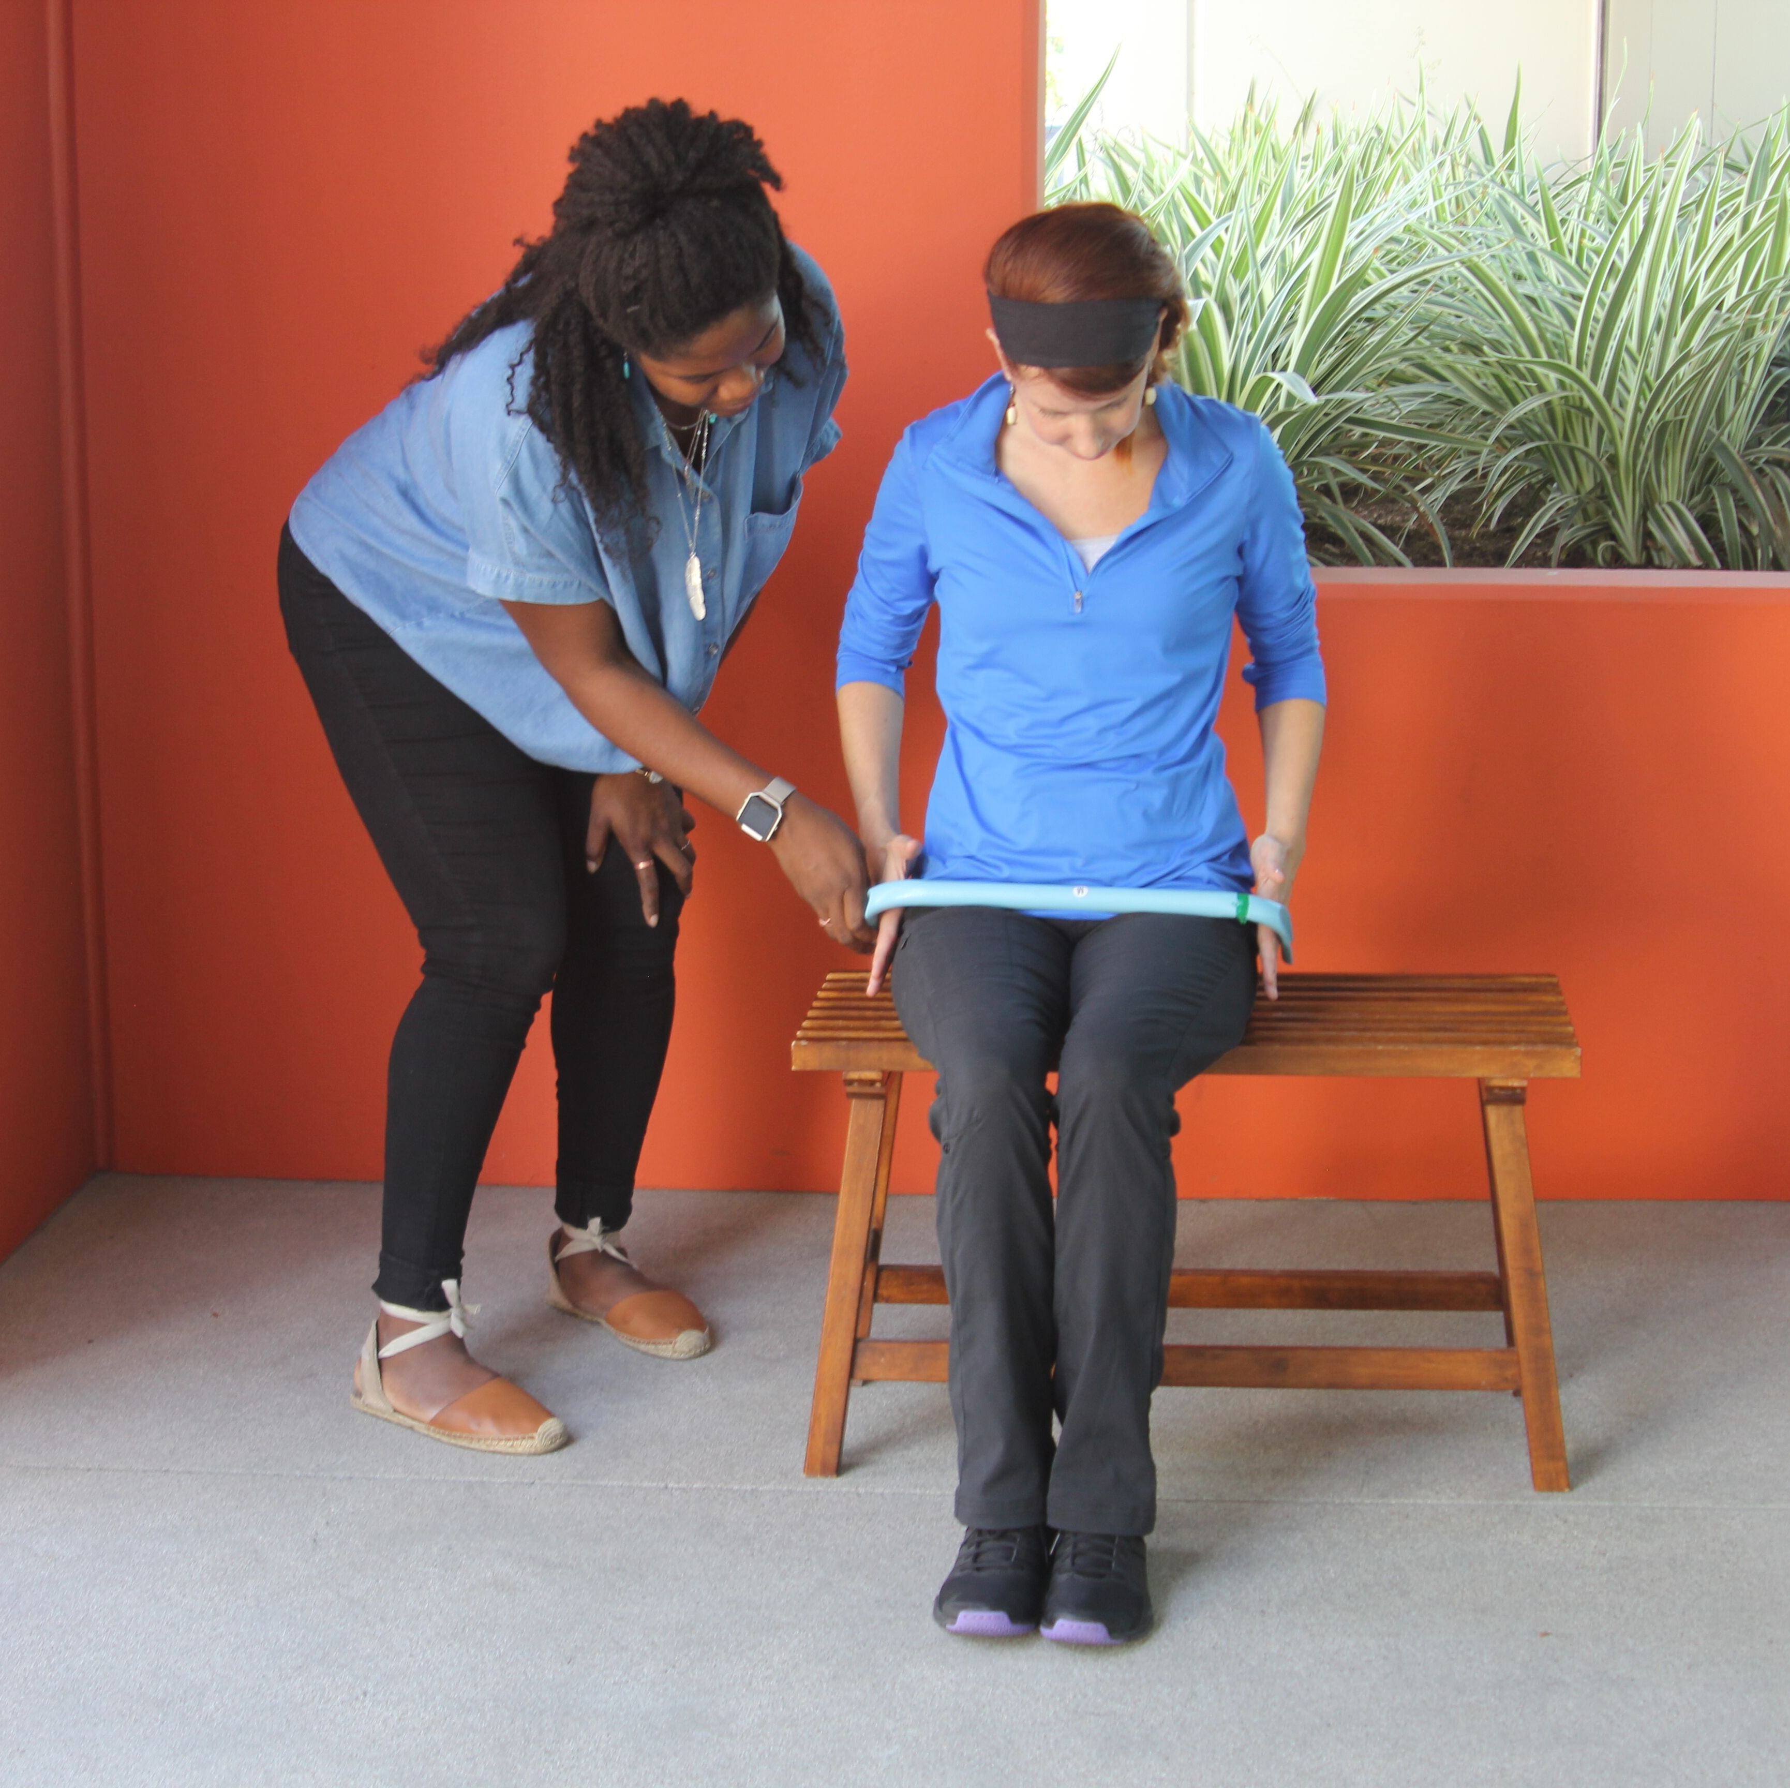
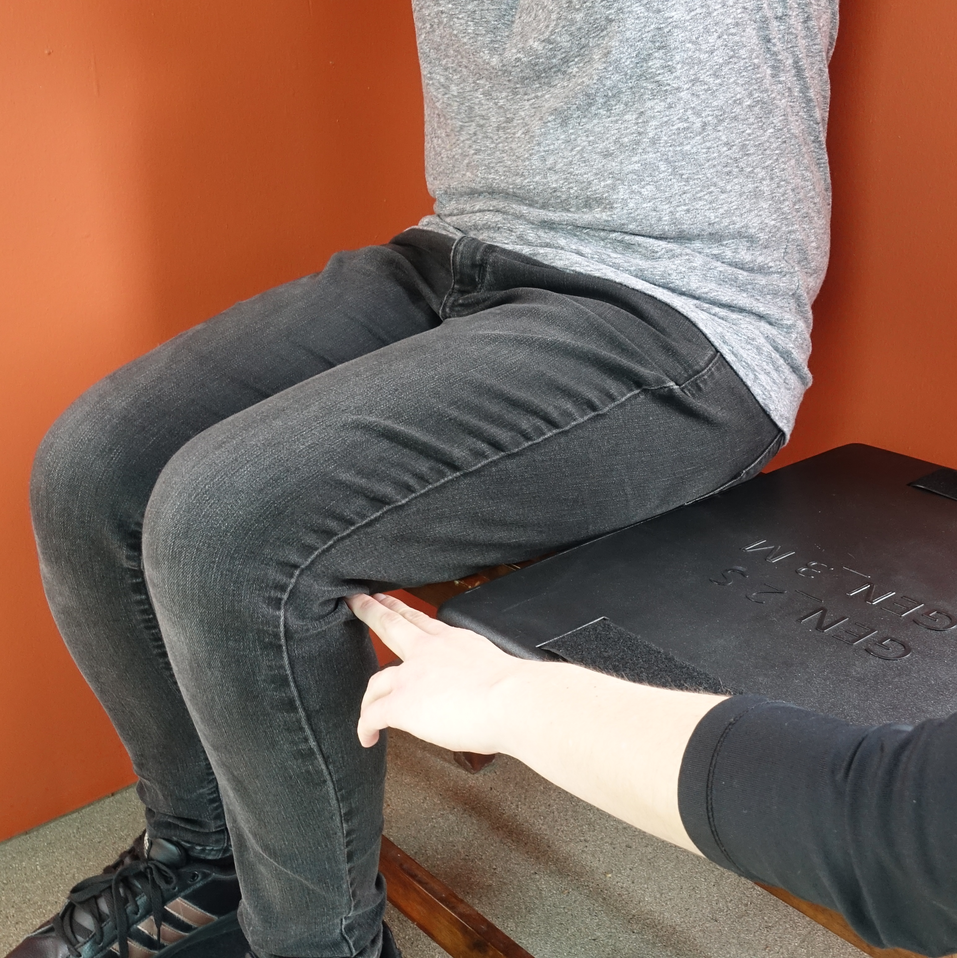
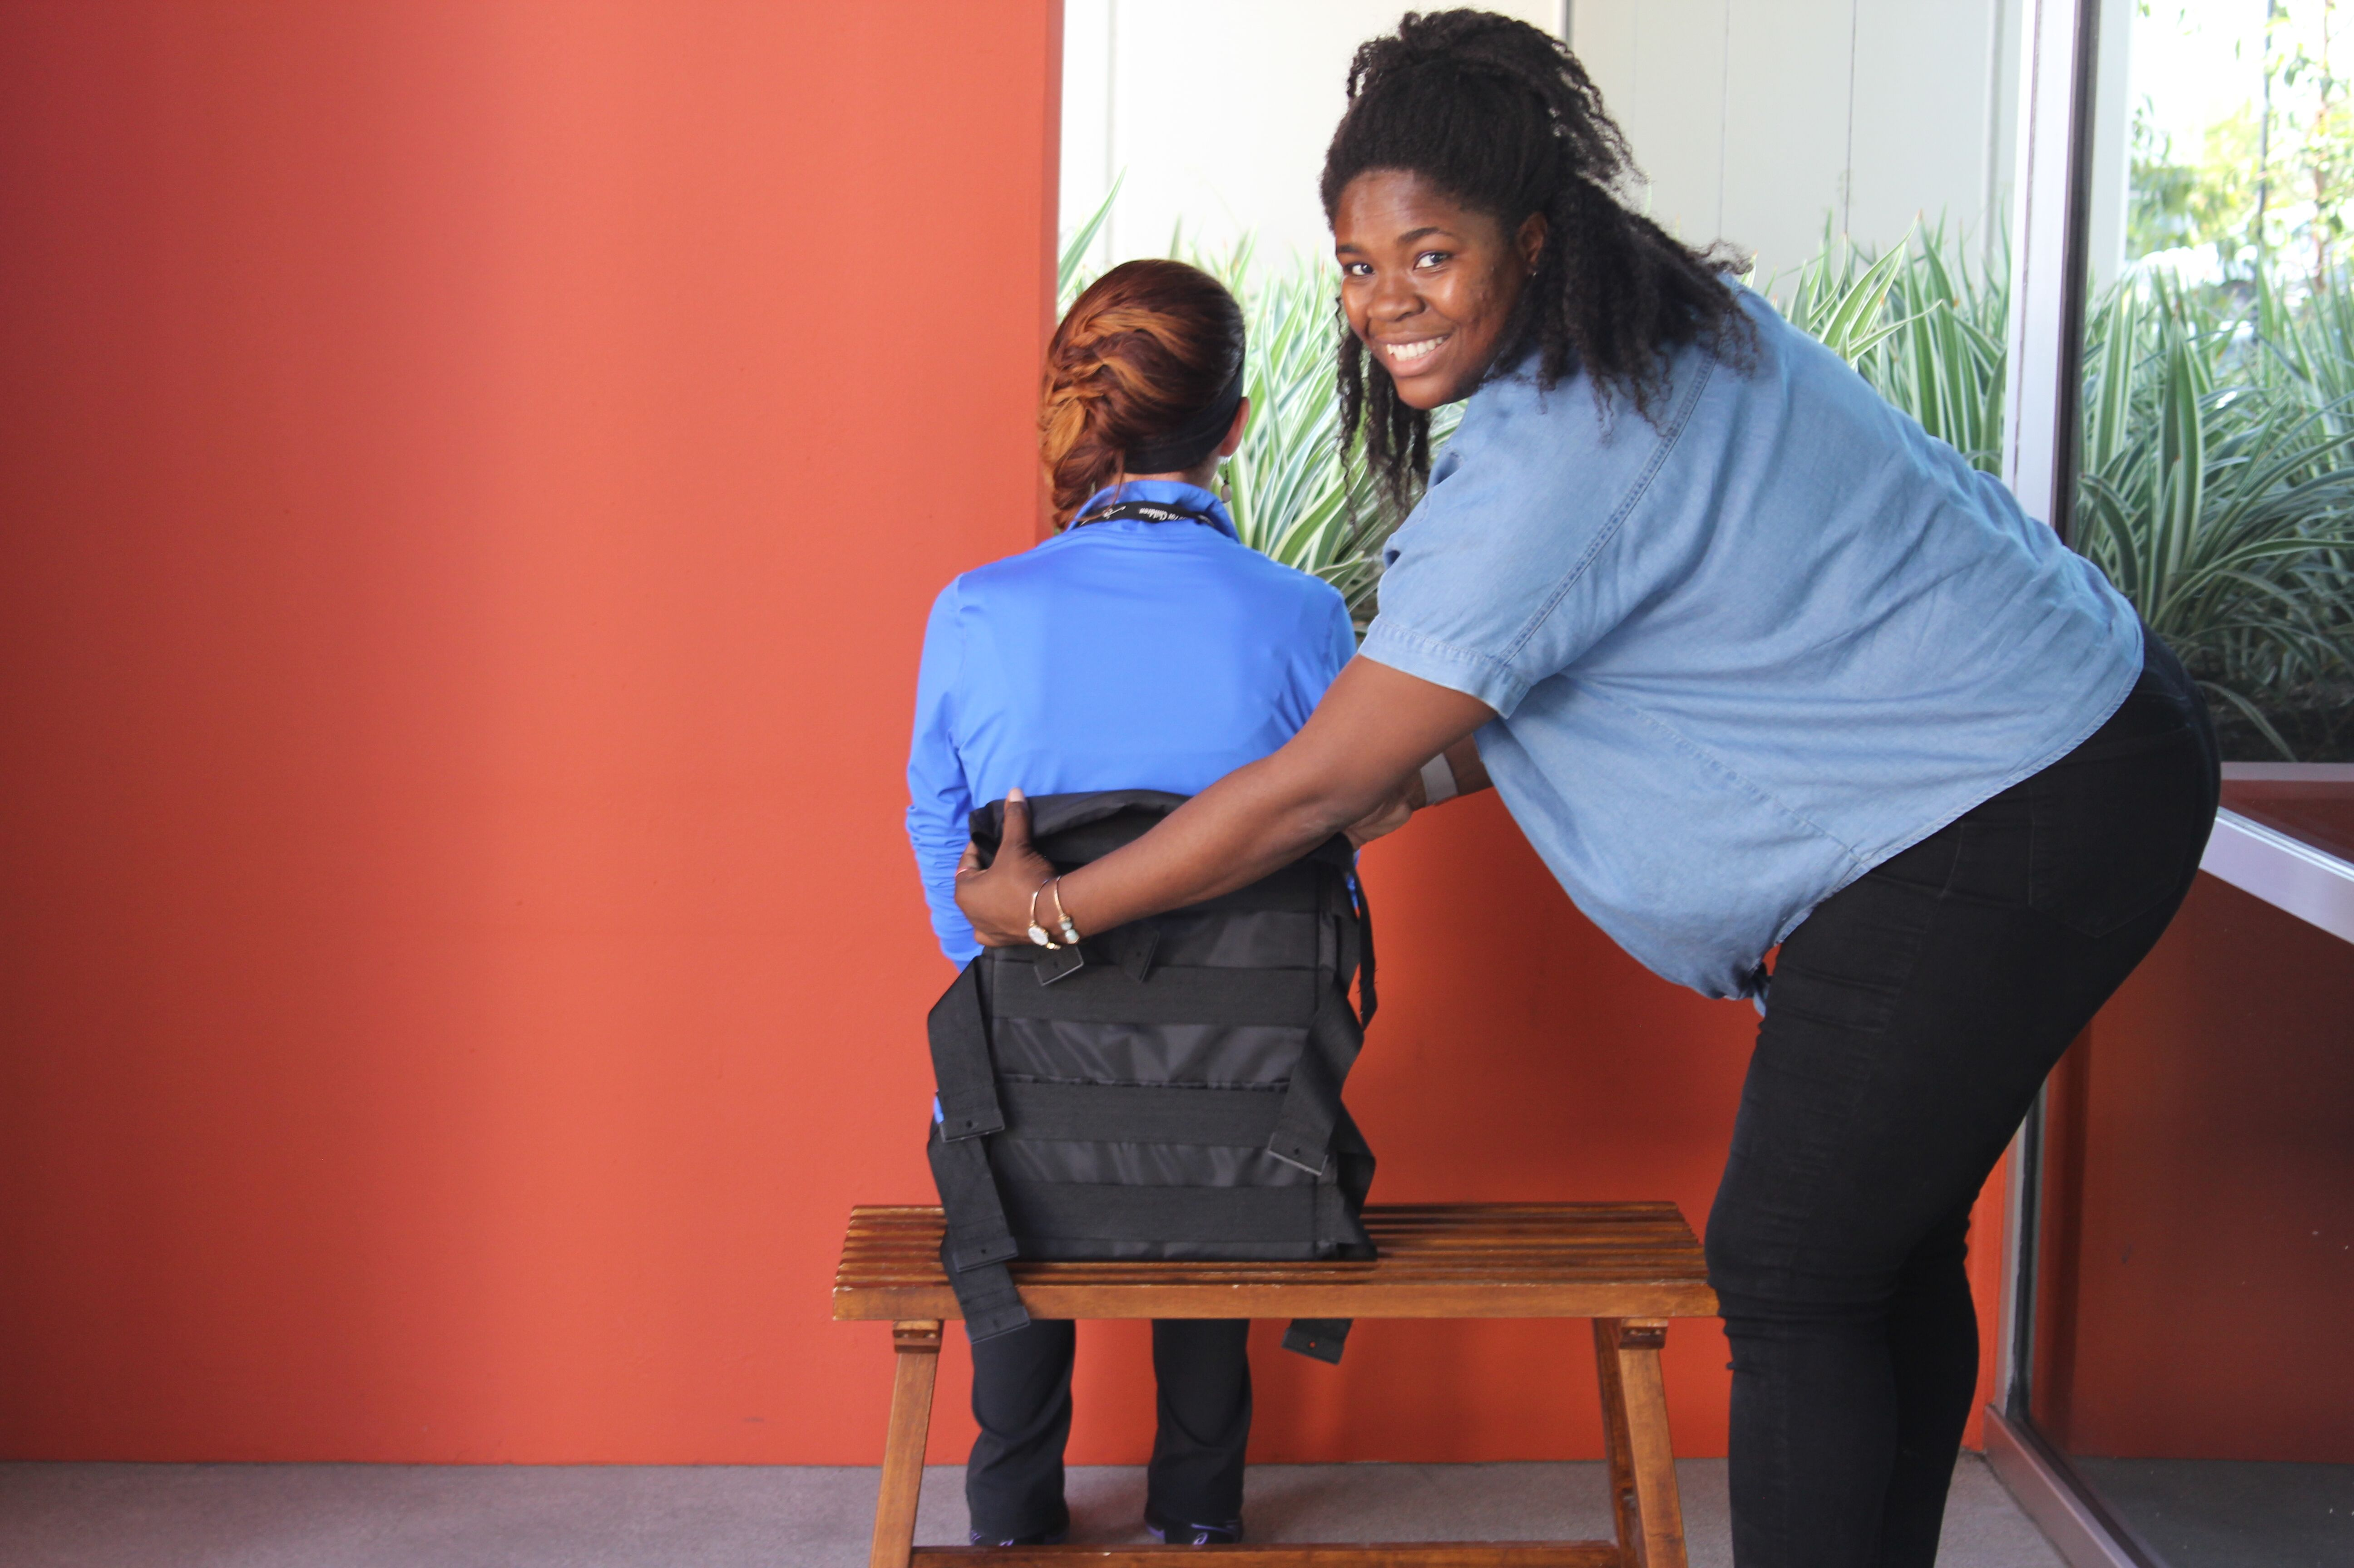
Ibibazo: Ibipimo bisanzwe

Slide 30
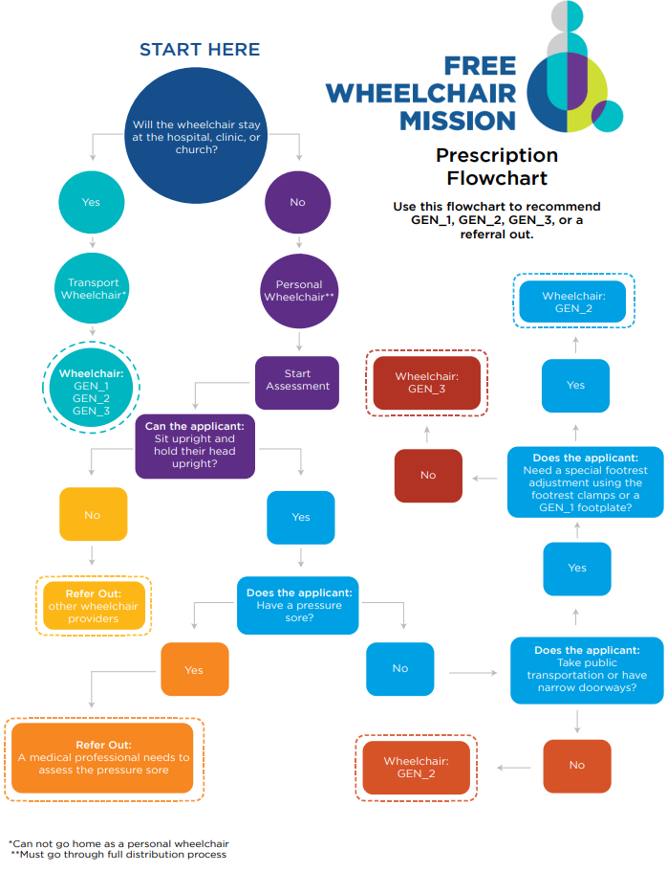
Igipapuro co kwa muganga
Kuraba ivyerekeye uwasavye n’ibipimo vyiwe hama ukagira ico usavye canke uhanuye c’umwihariko:
  GEN_1
  GEN_2
  GEN_3
  Kumurangira ahandi

Slide 31
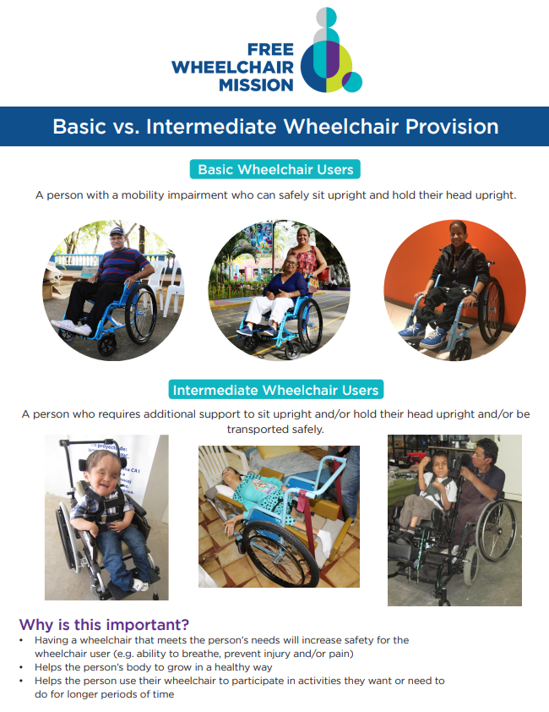
Kumurangira ahandi
Iyo umuntu akeneye ikinga, igice co kwongerako canke ikindi yofashwa bitandukanye nivyo dufise.
  Uwudutumbereye afise ibikomere vy’ukuryamira
    Tumurungika ku muganga yabigenewe
  Mu gihe amakinga y’ikigo FWM ari manini/mato cane
  Mu gihe adashobora kunywana n’imibiri yabo
  Adashobora kwisanzura neza ku mutwe wiwe
  Iyo akeneye imfashanyo yindi canke ikindi kintu
  comufasha kwiyunguruza.
Notes:
Picture of medical professional and other resources

Slide 32
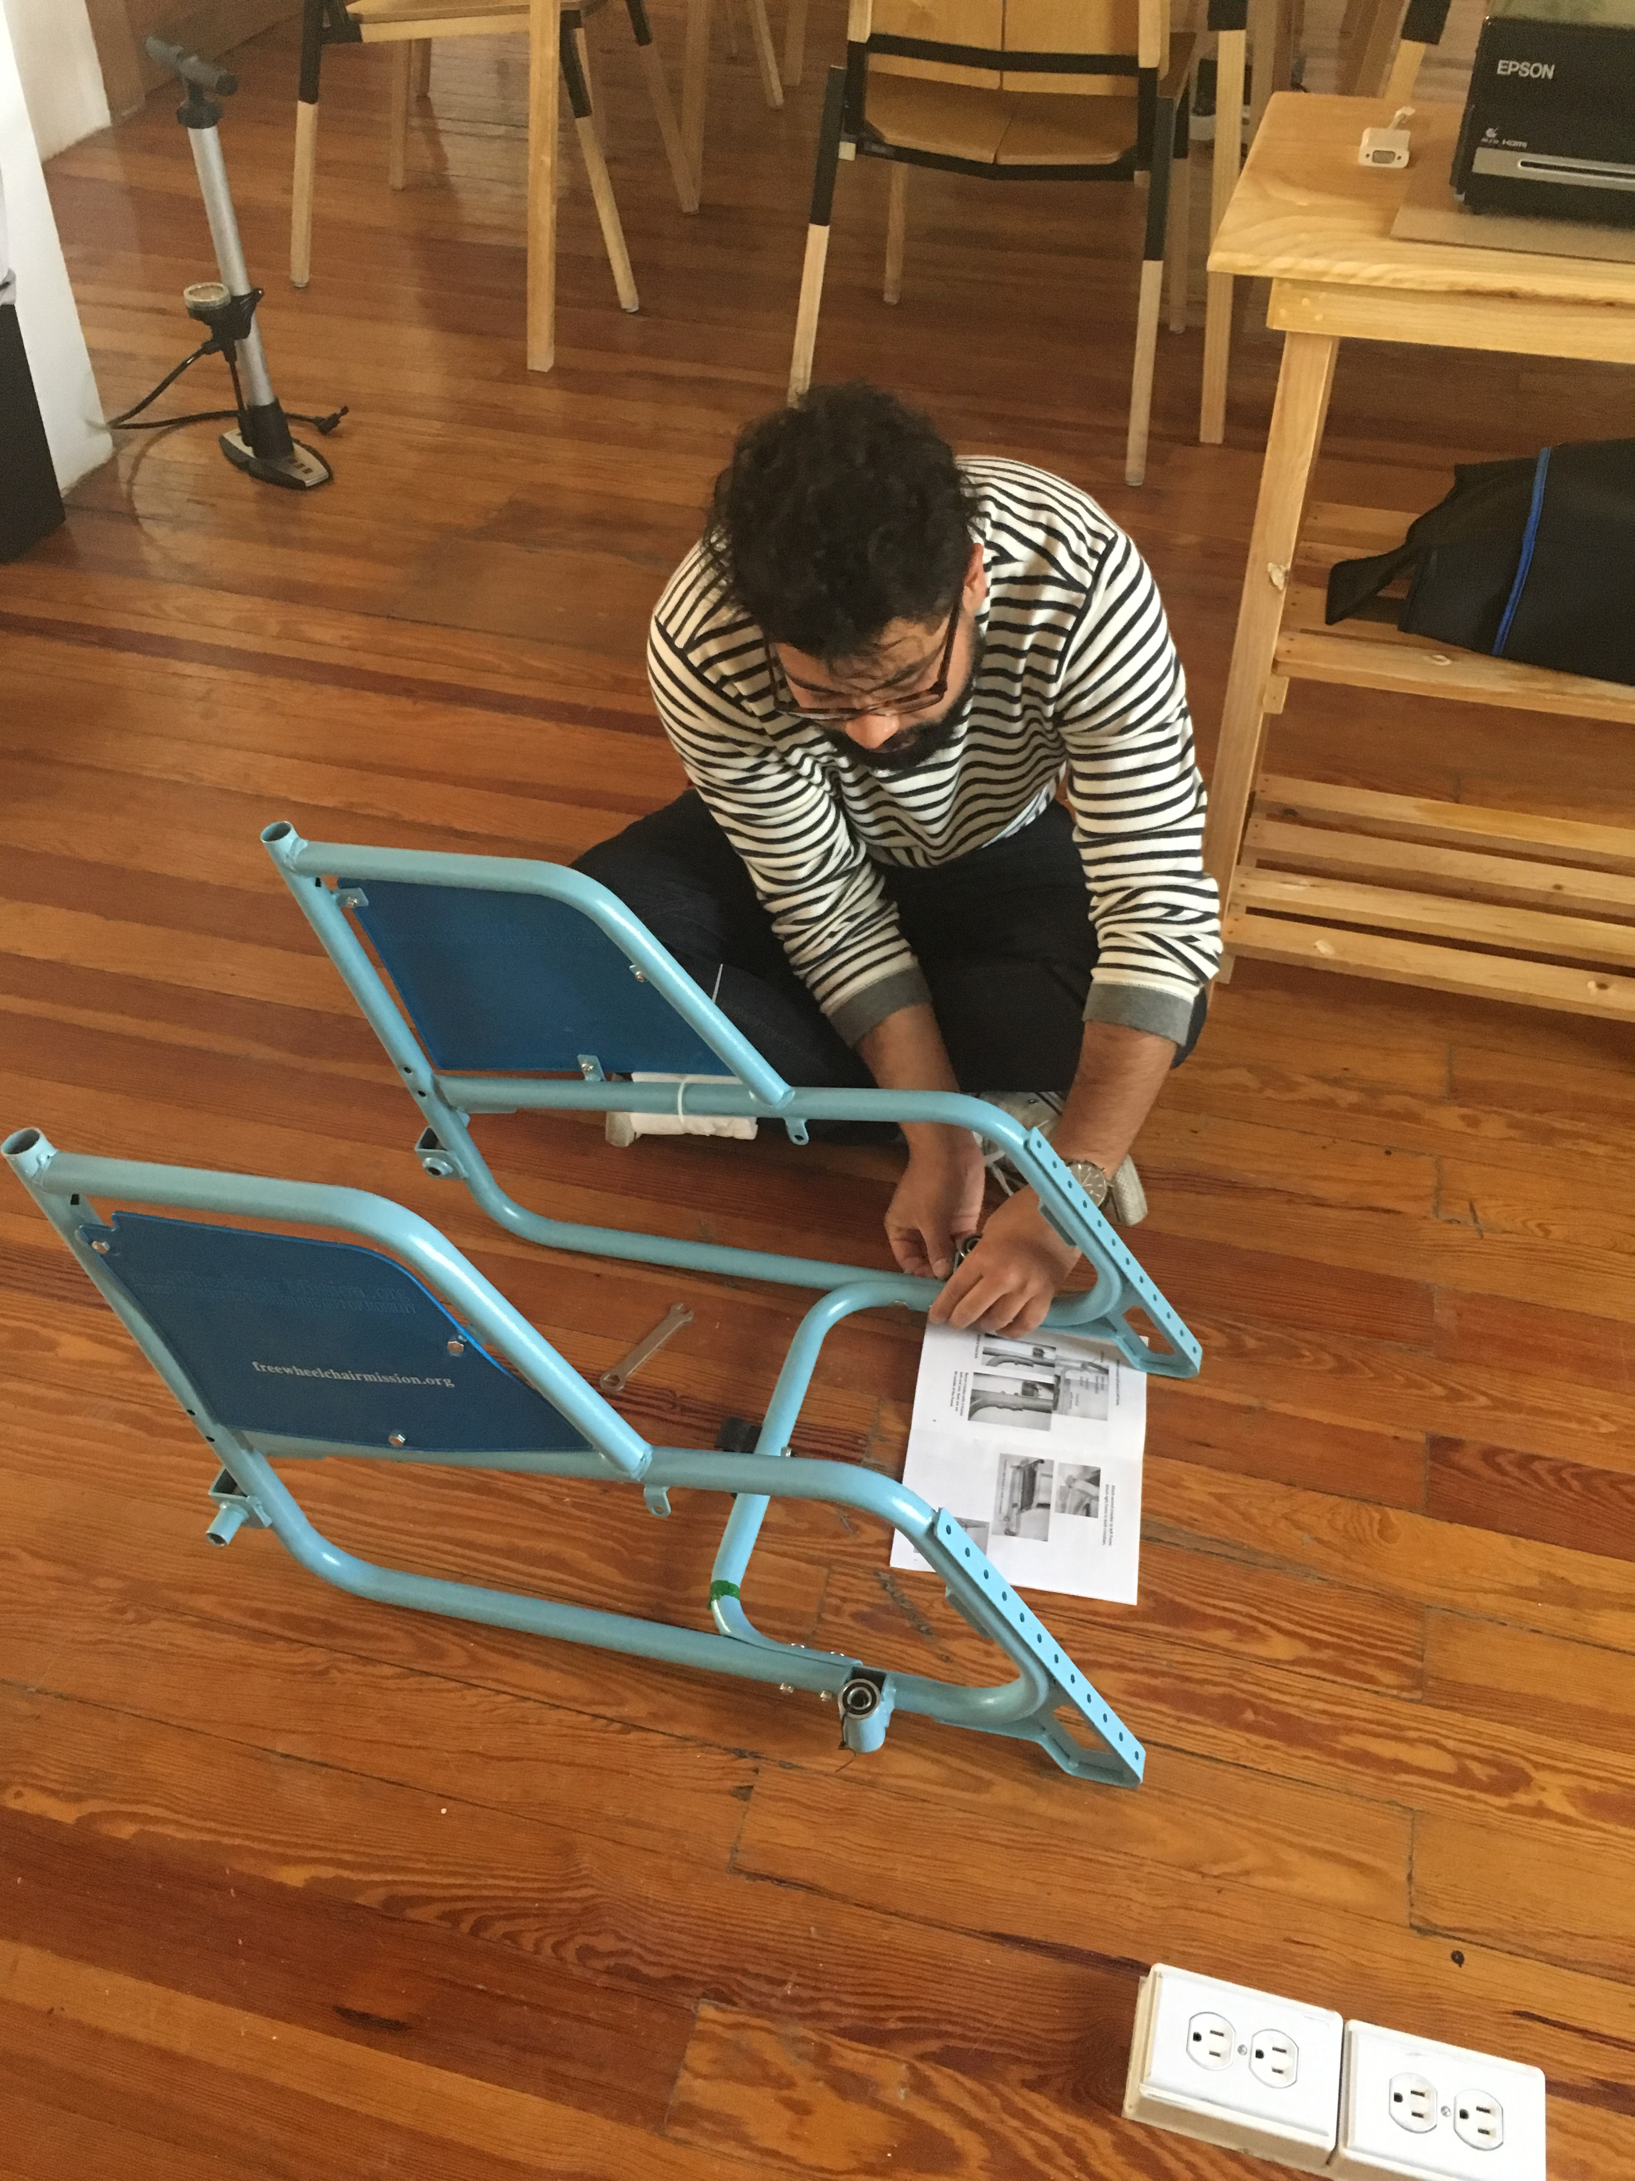
Kuriteranya
Uburyo bworoshe bwo guteranya amakinga y’ikigo ca FWM
  Igifata ibija kw’ikinga vyose (karakasi)
  Aho kwicara hafise aka matera.
  Aho kwegamira
  Amapine yose
  Amafire
  Umugozi w’umutekano w’uwutwara, uruhande
  rujamwo amaguru, n’ibindi..
Notes:
Frame of gen_3? Picture

Slide 33
Assembly Resources
Ivyo gufatanya
GEN_3
GEN_2
GEN_1
Kugira ipfundo
Gufatanya kimwe kimwe
Amapine ajamwo impwemu
Ibikenerwa mu kugufasha guteranya n’ukugumya neza

Slide 34


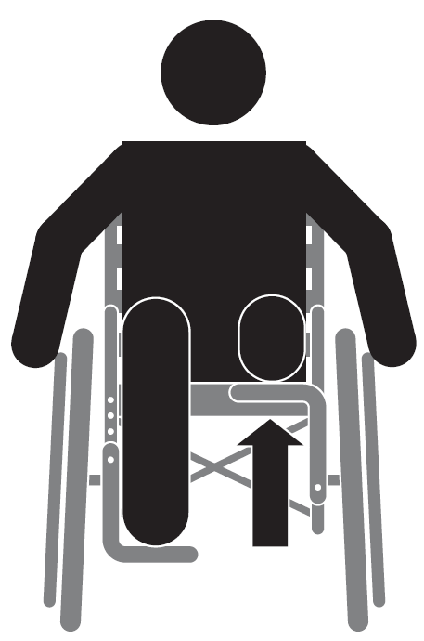
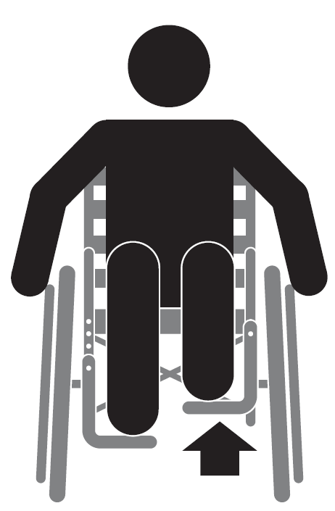
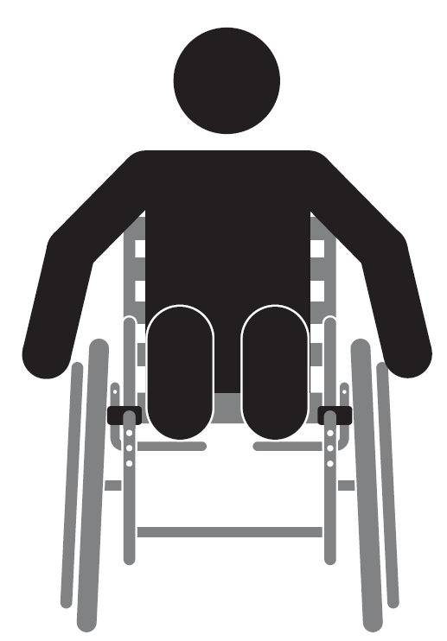
Gufatanya neza
GEN_2 Uburebure bw’aho kwicarako
Hagufi Habayabaye Harehare
GEN_3 Uburebure bw’aho kwicarako
GEN_2 Aho kwegamira
GEN_3 Aho kwegamira
Ahaja amaguru
Gucurika ugasuzuma ahaja amaguru
Amaja: hejuru/hasi
Aho bafungira ikijako amaguru
Kuhahengeka neza.

Slide 35
1.5 Inyigisho z’abayikoresha

Slide 36

Agatabo k’ukwo bayikoresha
Gutanga agatabo k’ukwo bayikoresha
  Kaba gatekeyemwo

Slide 37
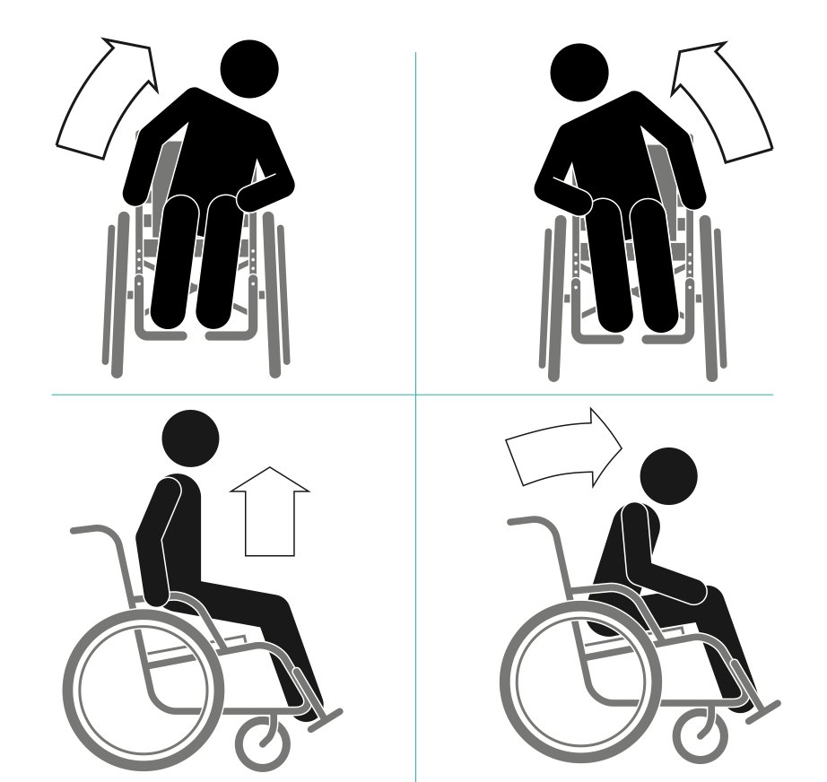
Imyimenyerezo n’inyigisho bigabanya ivyiyumviro
4 Imyimenyerezo
  Buri minota 15, gufata umunota 1
Gusuzuma umubiri mw’ijoro
Kwongereza umwanya wo kwicara bukebuke
Kugororoka neza

Slide 38
Kuvako kw’ikinga
Atawugufashije
Ufashijwe n’umuntu 1
Ufashijwe n’abantu 2
Imyimenyerezo yo gutora mitende

Slide 39
Gutwara neza
Amafire
Gutora mitende
Kwugurura/Kwugara GEN_3

Slide 40
Ubuhizi mu gutwara
Gutwara imbere
Gukata
Kuduga akadugo
Kuduga idodani
Kuduga esikariye
Gusubira inyuma
Kumanuka akadugo
Kumanuka idodani
Kumanuka esikariye

Slide 41
Ugusanura icapfuye
Gufatanya neza ibitagumye
Gushiramwo ipepu amapine
Ukwogesha amavuta ikarakasi

Slide 42
Ubutumwa
Ubutumwa
“Tubasangije ubu butumwa kw’izina ry’abagenzi banyu bo mu kigo Free Wheelchair Mission:
Umwami Yesu kristo arabakunda. Ninaco gituma muronkejwe iri kinga. Turizera tudakekeranya ko rino kinga rivuye ku Mana. Niyo yabaremye kadi irabakunda nkukwo ikunda Umwana wayo, ibakunda ukwo muri kwose.
Nkabizeye Yesu Kristo, Twahamagawe ngo dukorere abandi. Amasengesho yacu n’ukwo namwe ukwo mugendera kw’ikinga, mugumane ukwizera Imana, muyikorere, munaheshe icubahiro izina ryayo.
Imana ibahezagire cane.”

Slide 43
1.6 Gukurikirana

Slide 44
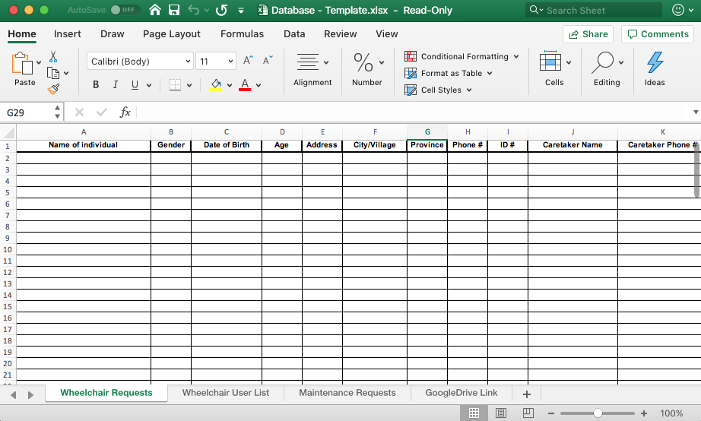
Kubika mu nyabwonko & Ivyemezo

Slide 45
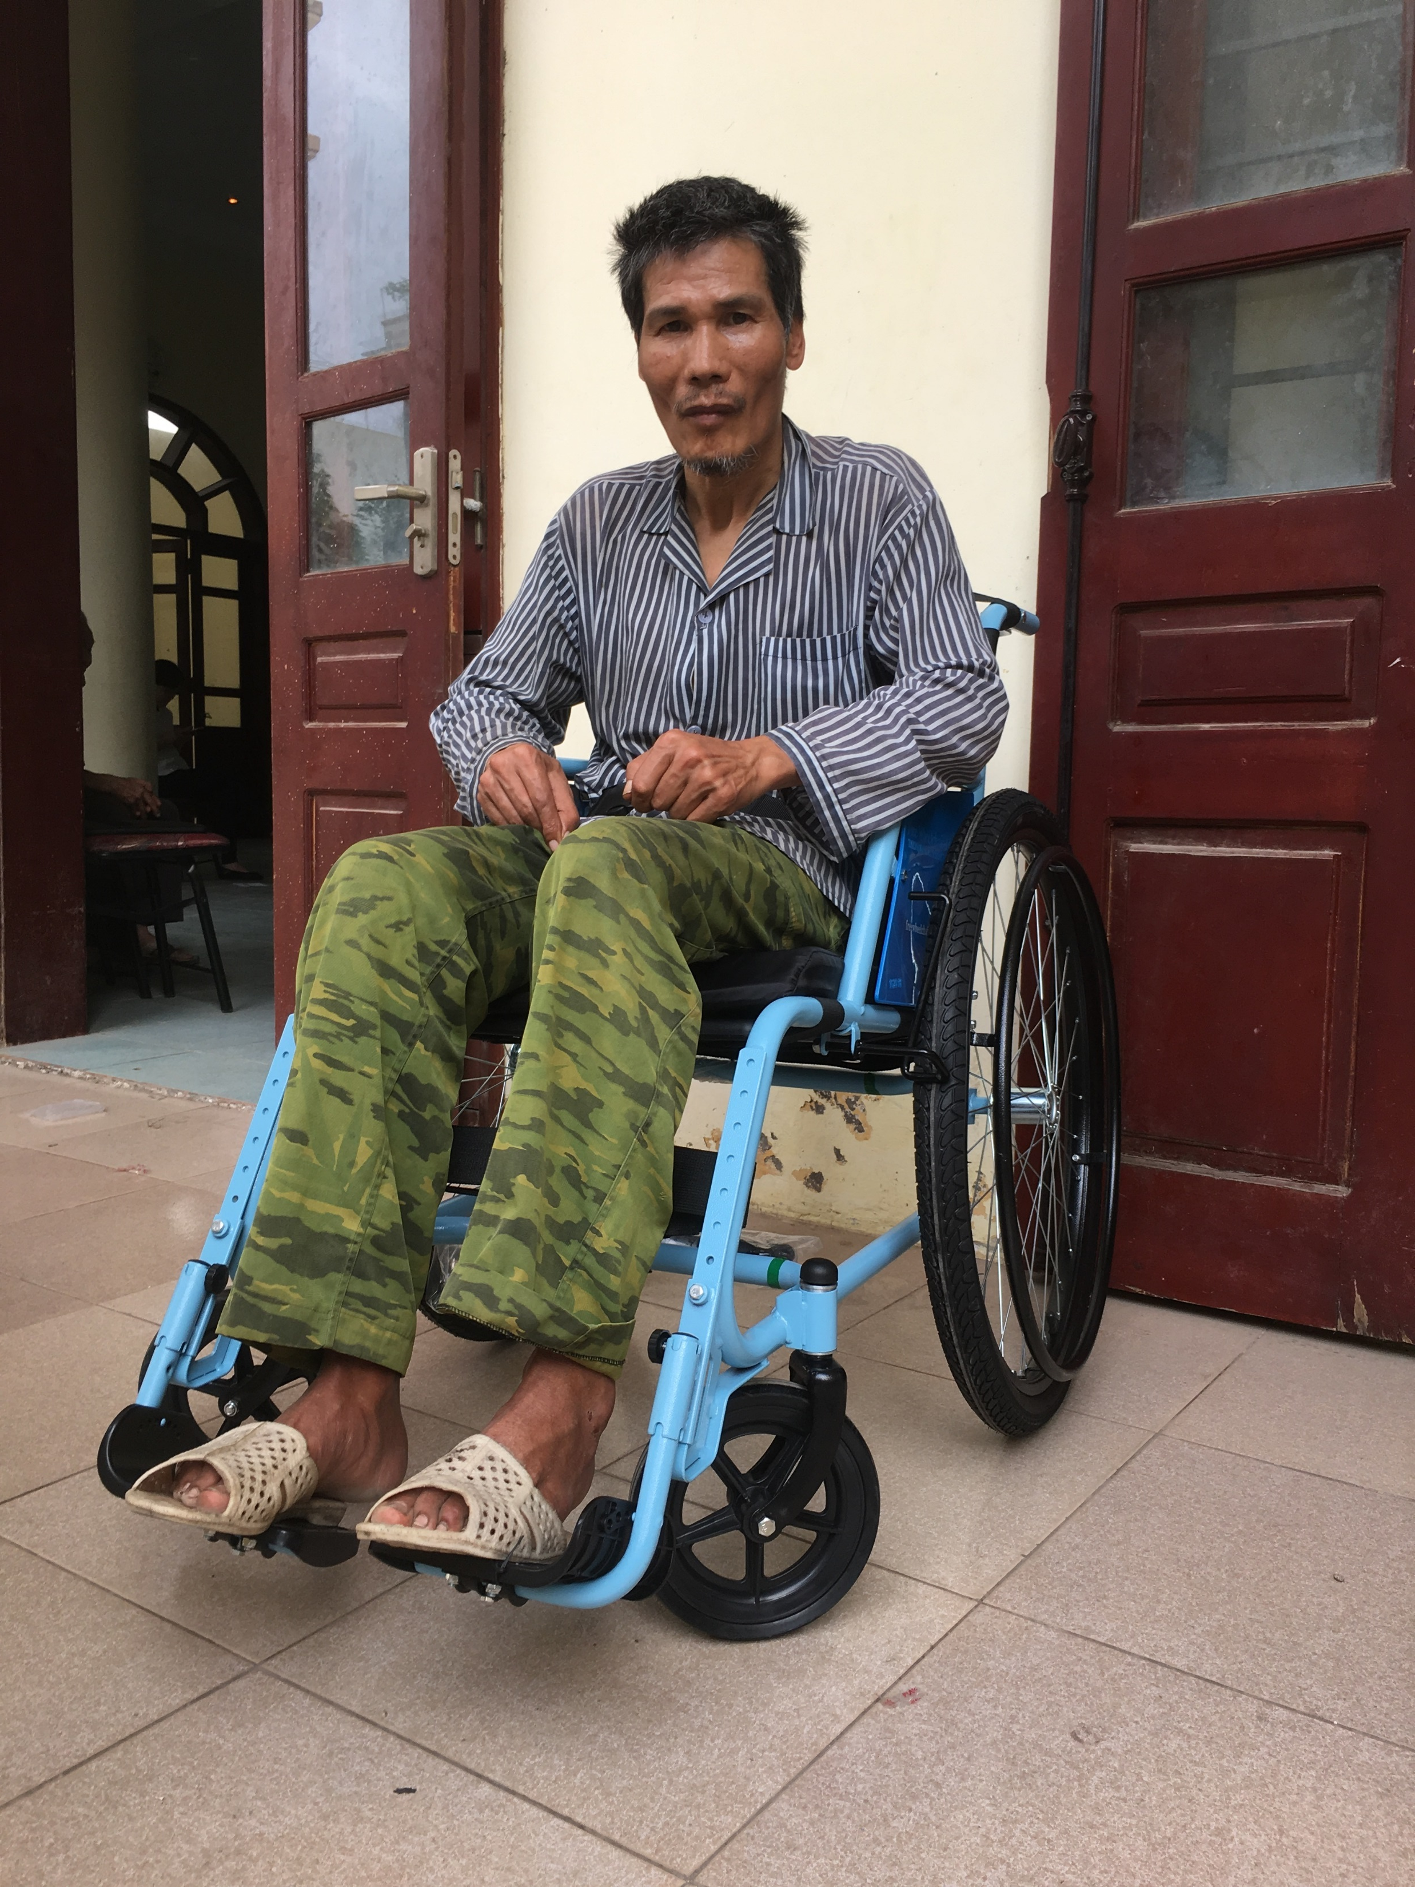
Kumenyesha
Kumenyesha ivya conteneri
  Amafoto
  Inkuru
  Amakuru y’ivyo twanditse muri mudasobwa
Kuyungurura
  Abo mwamana
Kuganira
  Gushira ku gihe igihindutse
  Ivyatorewe umuti & Ibigorana
  Imbuga nkoranyabaga

Slide 46
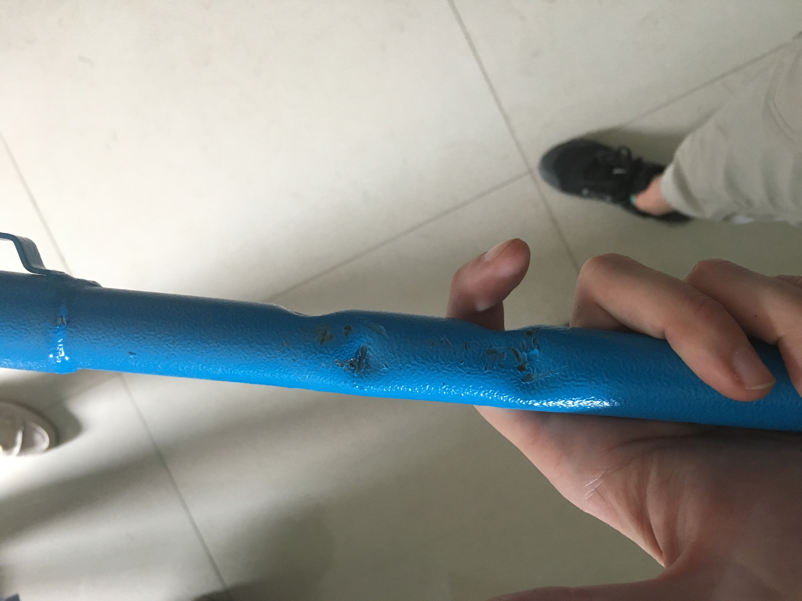
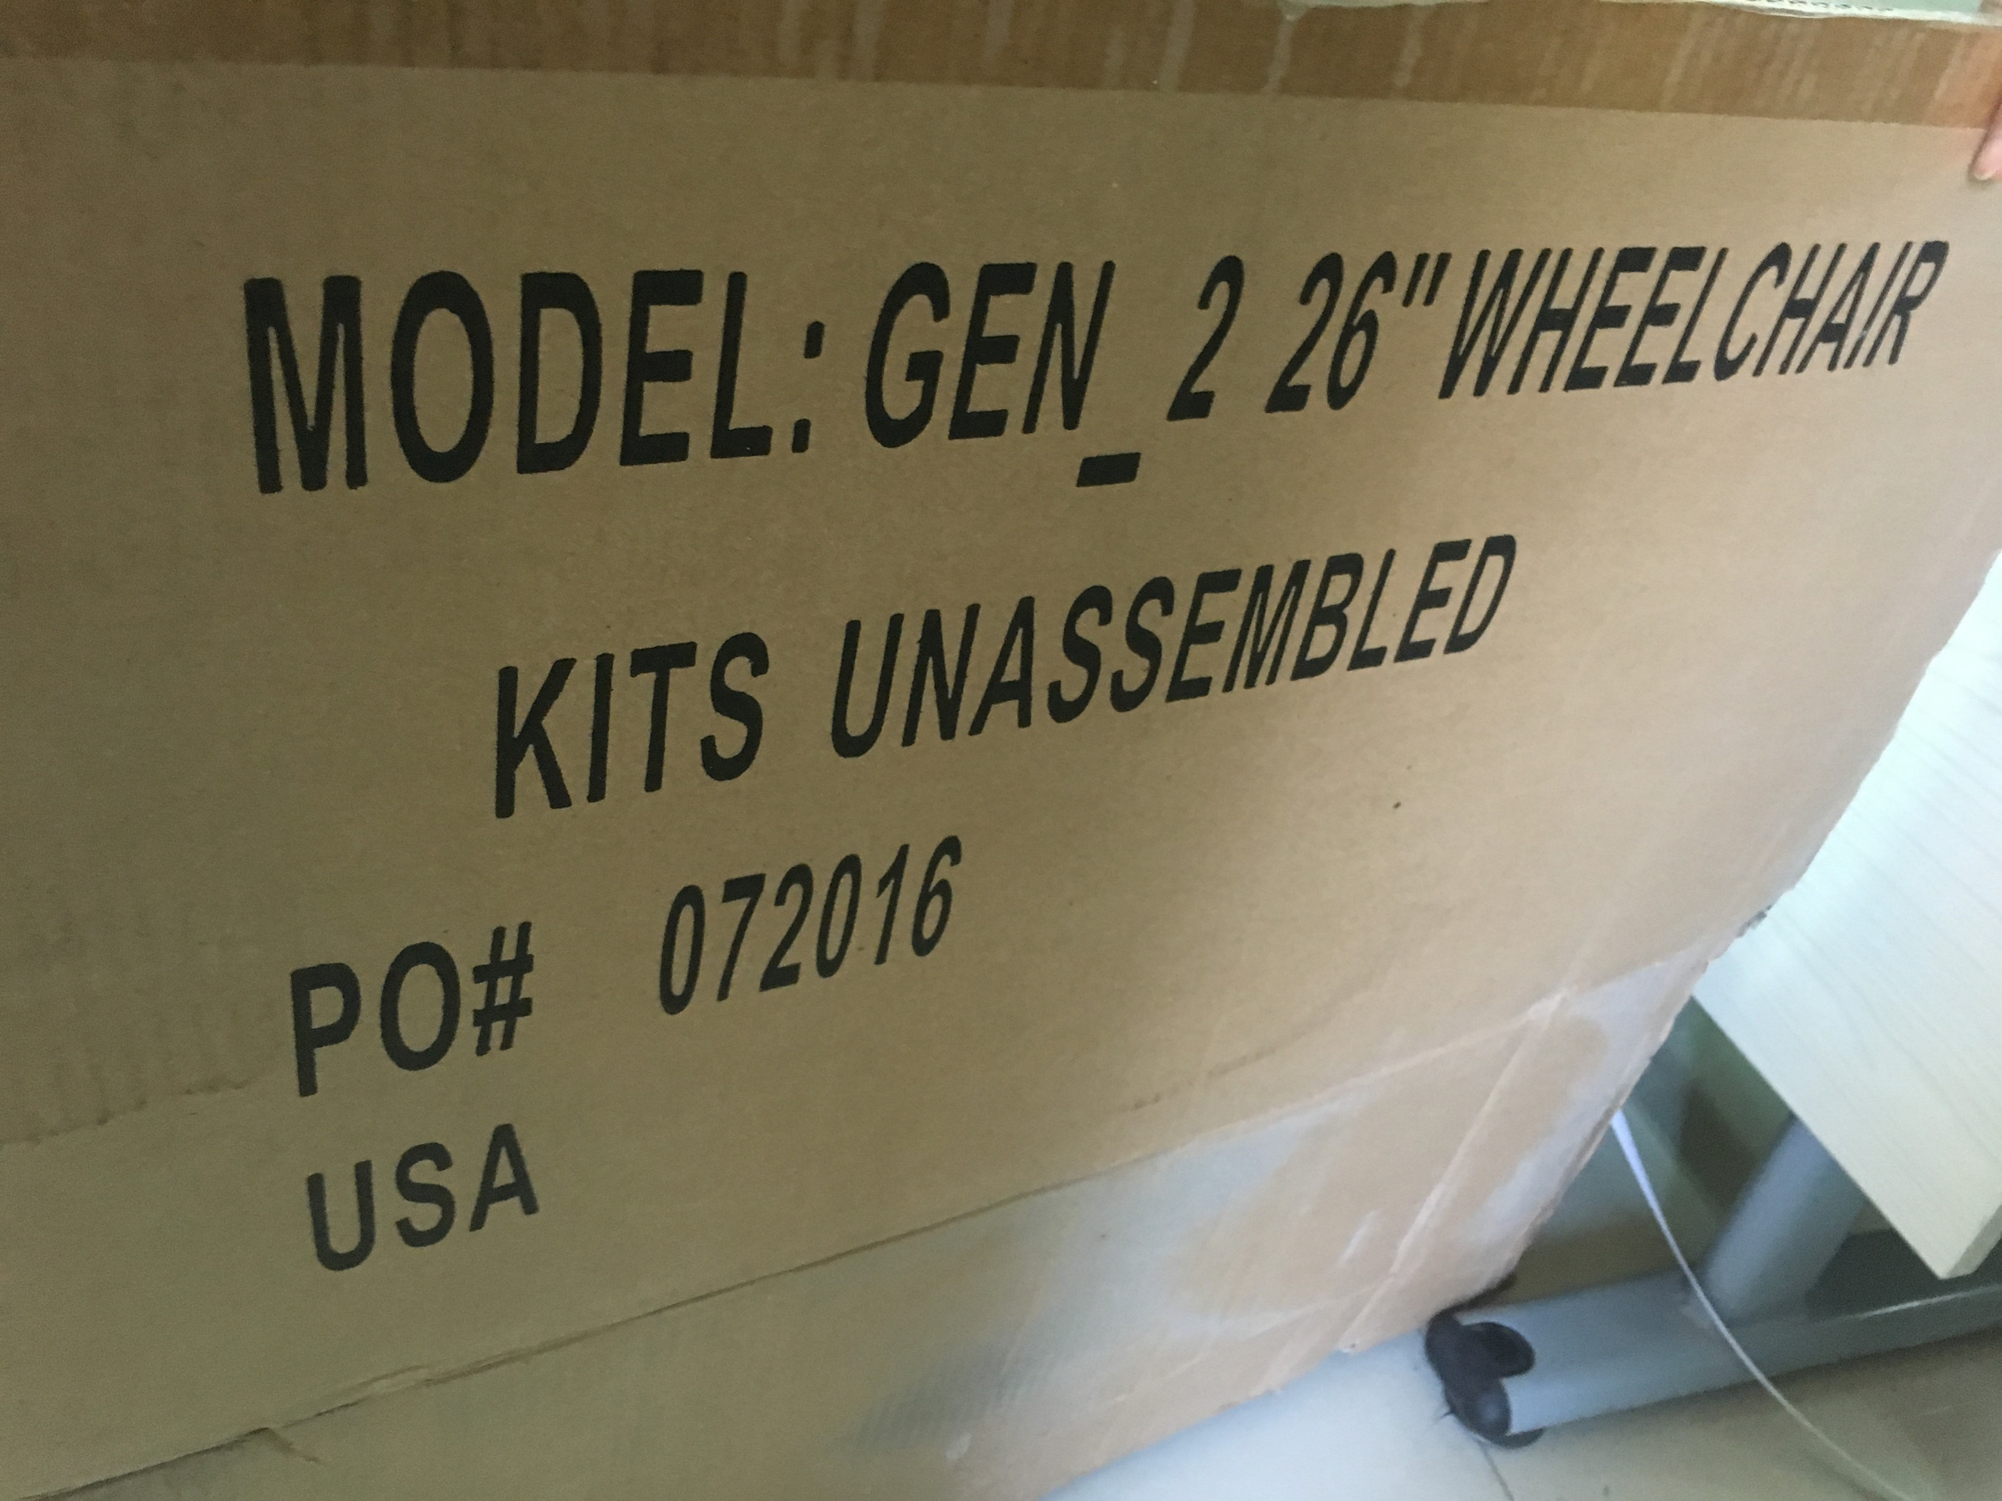
Gusuzuma ubukomezi (QC)
Kwuzuza urupapuro ruranga ubukomezi canke wandike ubutumwa kuri iyi WhatsApp #: +1 (323) 996-9198
  Ifoto
  Urupapuro rwo gusaba #
  Ico kibazo umaze kukibona incuro zingahe?
5/10 GEN_2s on May 20, 2019

Slide 47
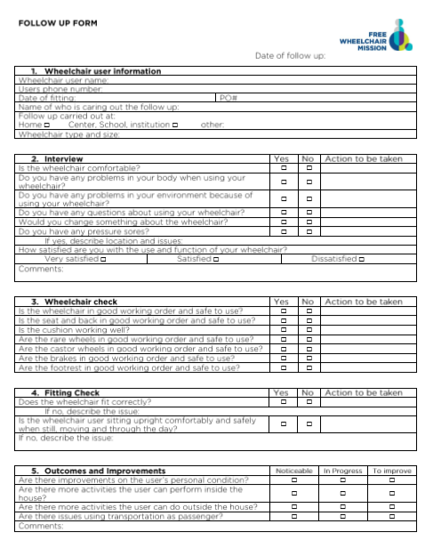
Urupapuro rwo Gukurikirana
Abafasha kubikurikirana:
Ba nyene gusaba amakinga
Ikigo ca Free Wheelchair Mission

Slide 48
Murakoze!

Slide 49
Aho twisunze
Best, K. L., Kirby, L. Smith, C. MacLeod, D. (2005). Wheelchair skills training for community-based manual wheelchair users: A randomized controlled trial. Arch Phys Med Rehabil Vol 86 2316-2323
ISWP - Seating and Mobility Access Toolkit (SMART). (n.d.). Retrieved June 21, 2019, from http://smart.wheelchairnetwork.org/
National Database of Nursing Quality Indicators. (n.d.). Pressure Injuries and Staging. Retrieved June 21, 2019, from https://members.nursingquality.org/NDNQIPressureUlcerTraining/Module1/Default.aspx
Shore, S. & Juillerat, S. (2012). The impact of a low-cost wheelchair on the quality of life of the disabled in the developing world. Med Sci Monit 18(9), CR533-542
Toro, M.L., Eke, C., & Pearlman, J. (2016). The impact of the World Health Organization 8-steps in wheelchair service provision in wheelchair users in a less resourced setting: a cohort study in Indonesia. BMC Health Services Research 16:26
UN General Assembly, Convention on the Rights of Persons with Disabilities : resolution / adopted by the General Assembly, 24 January 2007, A/RES/61/106, available at: https://www.refworld.org/docid/45f973632.html [accessed 23 February 2019]
Werner, D. (2009). Disabled Village Children. Berkeley, CA: The Hesperian Foundation.
World Health Organization. (2008). Guidelines on the provision of wheelchairs in less resourced settings. Retrieved from http://www.who.int/disabilities/publications/technology/wheelchairguidelines/en/
World Health Organization. (2012). Wheelchair service training package — Basic level. Retrieved from
http://www.who.int/disabilities/technology/wheelchairpackage/en/
Zollars, J.A. (2010). Special Seating: An Illustrated Guide Revised Edition. Albuquerque, NM: Prickly Pear Publications.

Slide 50


Ahandi mushobora kuronkera ubumenyi bwavyo
Ushobora kuronka ubumenyi burushirije ku rubuga rw’abo dufashanya:
https://www.freewheelchairmission.org/dp-home
Akanyegezwabanga: GEN_123
Urashobora kuja mu murwi n’abandi wa Facebook:
www.facebook.com/groups/FWMdistributionpartners
Ushaka amakuru yerekeye amakinga y’abamugaye canke inyigisho, ja kuri:

