Slide 1
Basic Wheelchair Training
For Distribution Partners
Hybrid Remote & Full In-Person
Date:
FY20 V2-062419

Slide 2

Welcome to FWM Basic Wheelchair Training!
Ilse Caballeros, OT/PT, MAEF
Central America Regional Trainer
Free Wheelchair Mission
icaballeros@freewheelchairmission.org
Based in Guatemala
Crystal Jackson, MPH
Medical Programs Coordinator
Free Wheelchair Mission
cjackson@freewheelchairmission.org
Based in California
Nicole VanderZouwen, MS, OTR/L, ATP
Medical Programs Manager
Free Wheelchair Mission
nvanderzouwen@freewheelchairmission.org
Based in California
Team Transformation Name & Credentials
Profession
Contact Information
Location

Slide 3
Zoom

Slide 4
Agenda
Day/Time | Topics/Activities
 | 1.1: Introduction
 | 1.2: Process
 | Break (5-10 minutes)
 | 1.3: Disability & Physical Condition
 | Break
 | 1.4: Fit
 | Break (5-10 minutes)
 | 1.5: User Training
 | 1.6: Follow-up

Slide 5
Goal
Identify appropriate wheelchair provision
Review FWM partner expectations/requirements
Recall resources

Slide 6
1.1 Introduction

Slide 7

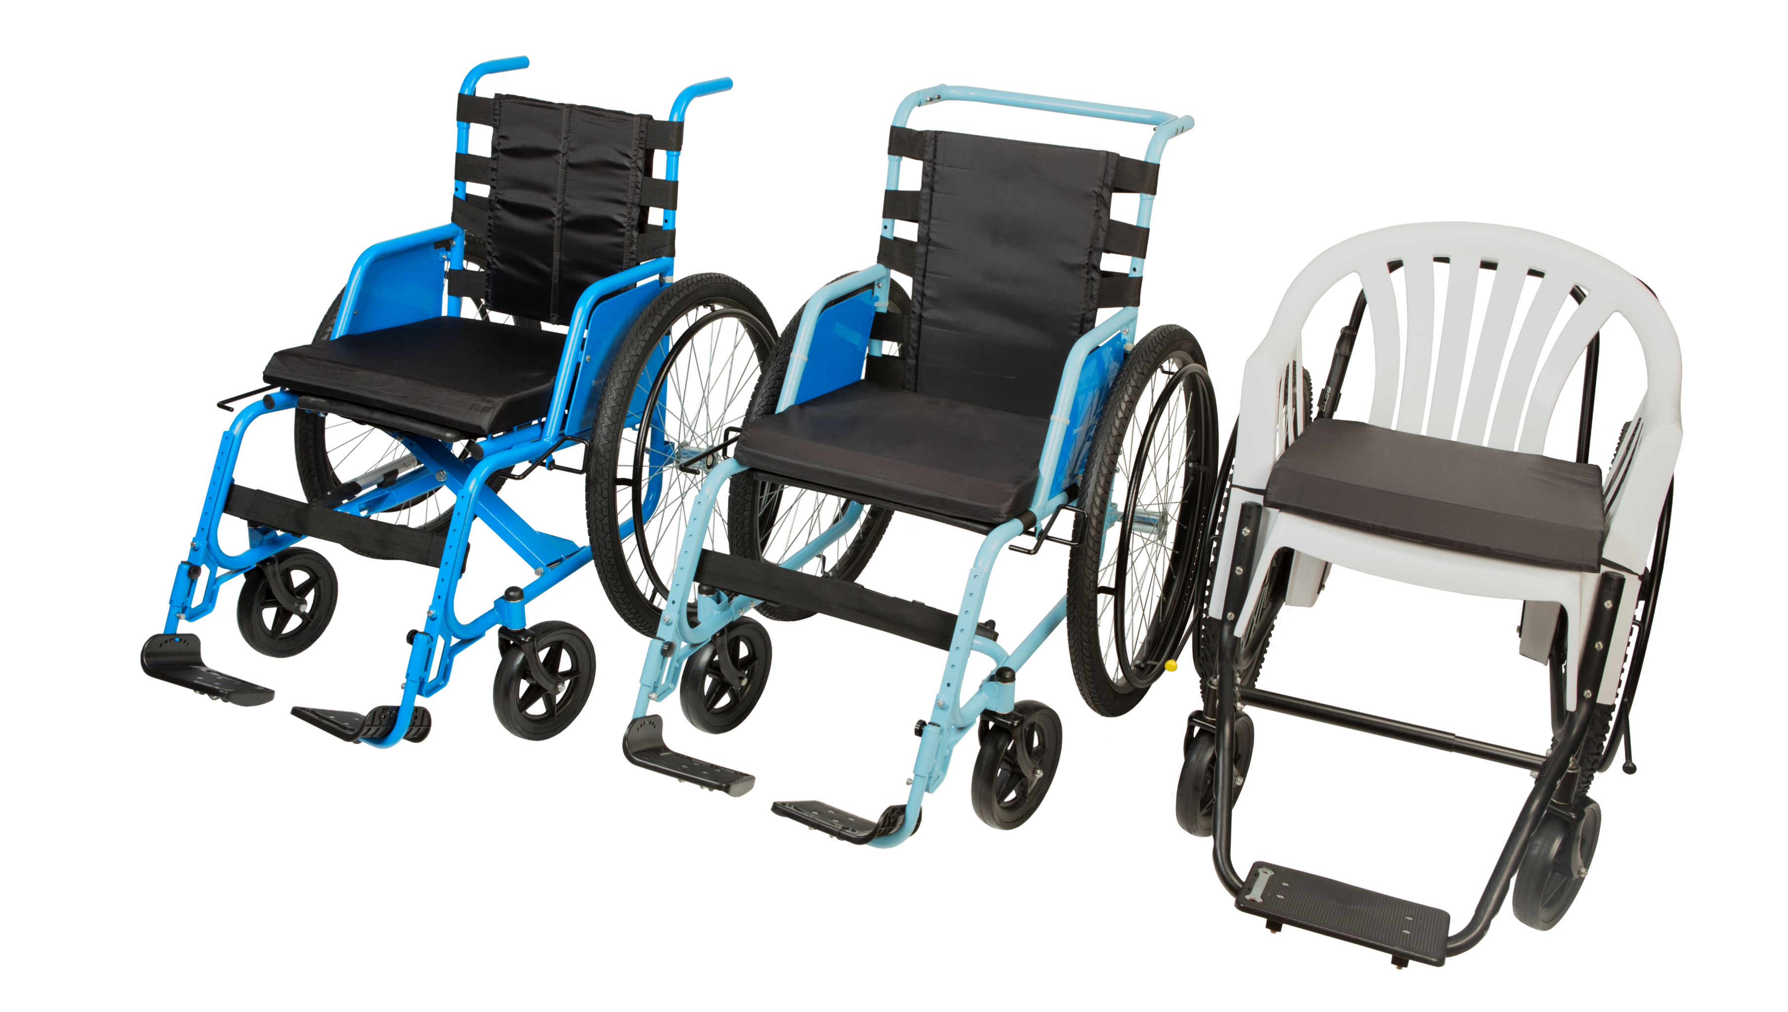
Introduction: Free Wheelchair Mission (FWM)

Slide 8
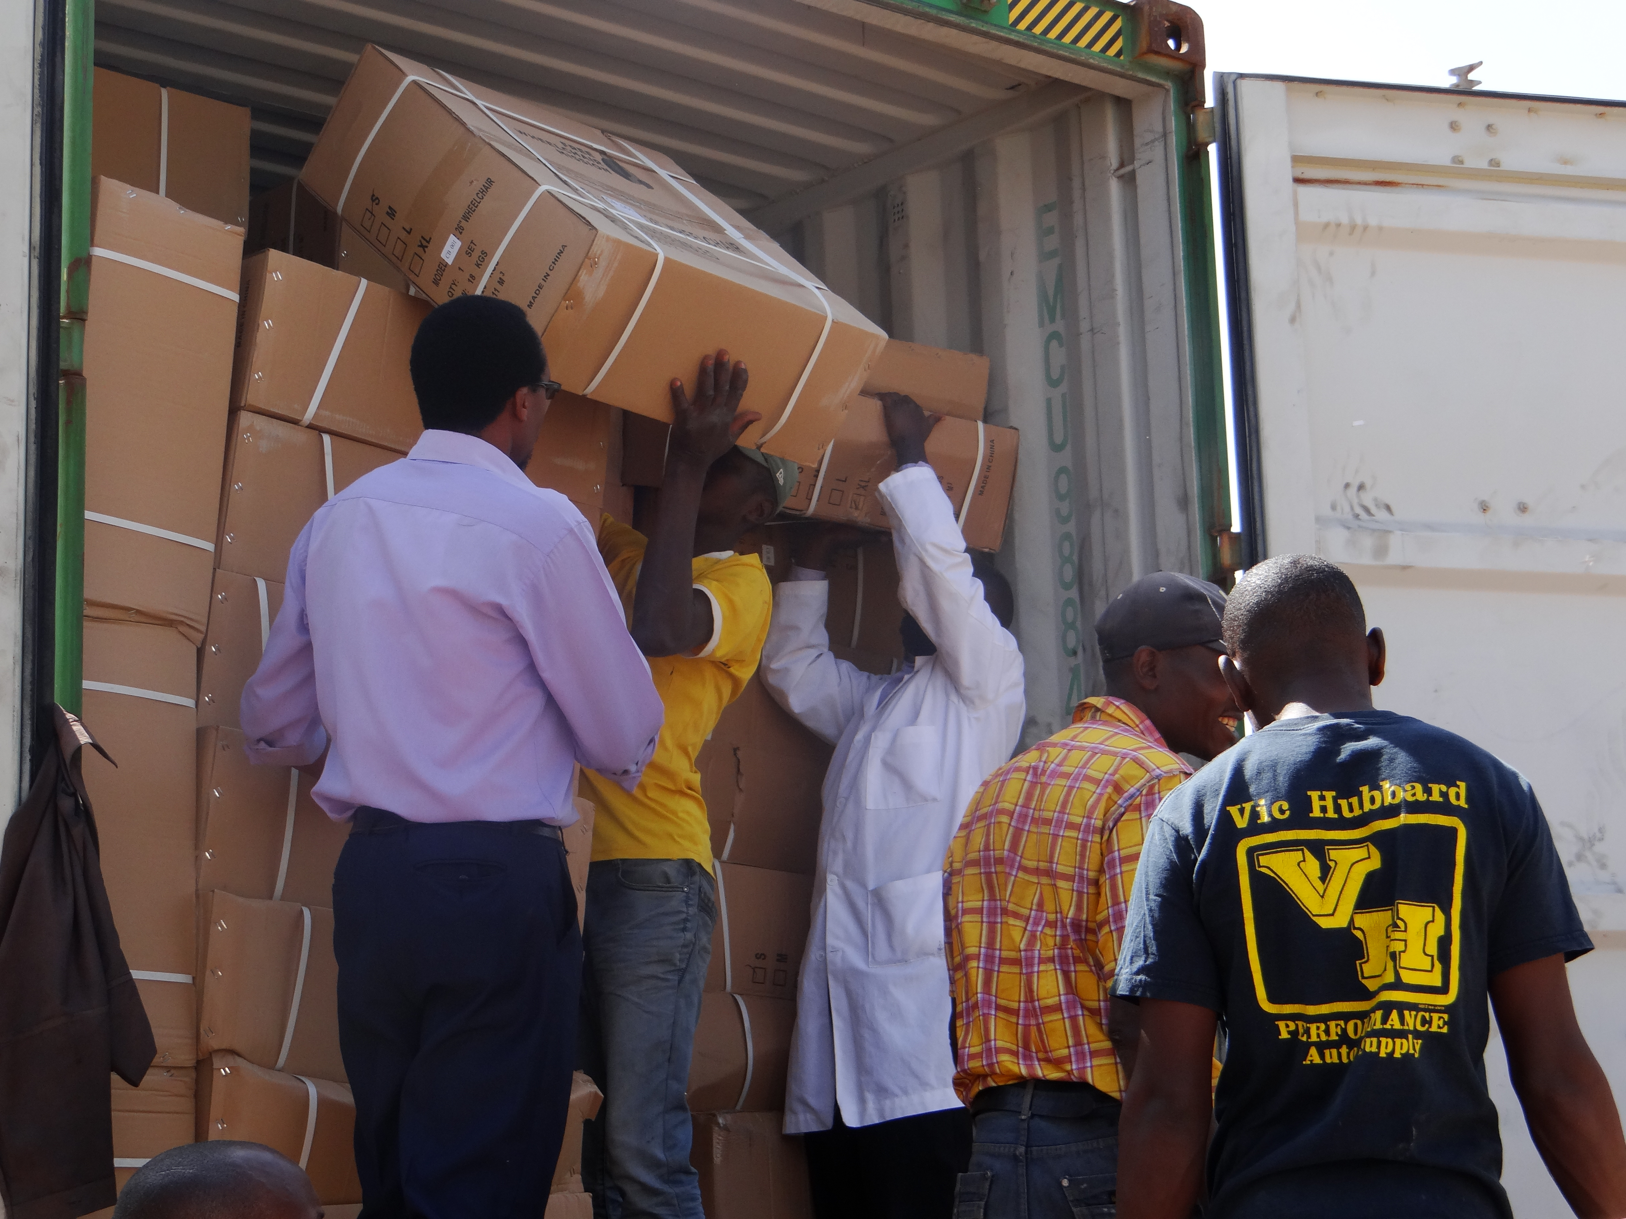
Introduction: Our Containers
Container Size:
  40 Foot
Wheelchair Type:
  Container Mixes Pre-Set
Wheelchair Quantity:
  Range 440-550
User Manual Languages Available:
  At Request
Spare Parts:
  Custom Order

Slide 9
Introduction: Our Wheelchairs

Slide 10



Introduction: Our Standards
Always SCREEN clients (Application/Prescription)
ASSEMBLE and ADJUST for everyone
Never give UNASSEMBLED kits
Get medical approval if the client has PRESSURE SORES
Only provide a wheelchair that SAFELY SUPPORTS the client’s body
Never CHARGE the client
Always do USER TRAINING

Slide 11
Introduction: Our Resources
Resources
Workbook
Power
Point
Mini Manual
Youtube Videos
User Manual
Assembly Manual
Posters
Database Example
Website
Online Modules
Facebook

Slide 12
Introduction: Country Specifics
This will need to be based on the country and approved by me ☺

Slide 13
1.2 Distribution/Provision

Slide 14

Workbook
Application
Fit Form
Safe & Ready Checklist
Fit Confirmation Form
User Training Checklist

Slide 15
Before
Referral & Assessment
#1
Review Applications
#2
Check Inventory
#3
Schedule Event
#4
Review Training
#5

Slide 16
During
Application
Fit Form
Safe & Ready Checklist
Fit Confirmation Form
User Training Skills Checklist
Prescription/ Assembly
Assessment
Adjustments

Slide 17
After
Update the Database
Referrals
Container Report
Quality Control Reporting
Follow-up

Slide 18
1.3 Disability & Physical Condition

Slide 19
Definition & Causes
“Persons with disabilities include those who have long-term physical, mental, intellectual or sensory impairments which in interaction with various barriers may hinder their full and effective participation in society on an equal basis with others.”
UN General Assembly, Convention on the Rights of Persons with Disabilities
What are the causes of disability
  Birth
  Illness or Infection
  Injury
  The environment

Slide 20
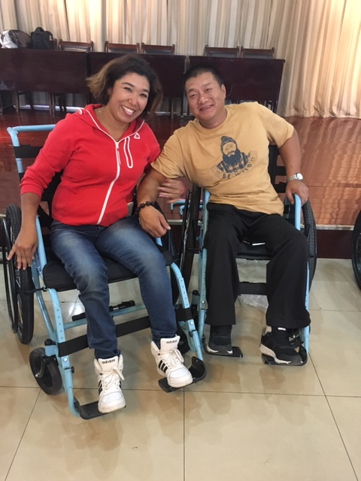
Disability Awareness & Language
Treat people how you would want to be treated:
  Ask before you help
  Explain what you are doing
  Talk to the person in the wheelchair first
  Use appropriate language
  Tell them about any other programs your organization offers

Slide 21

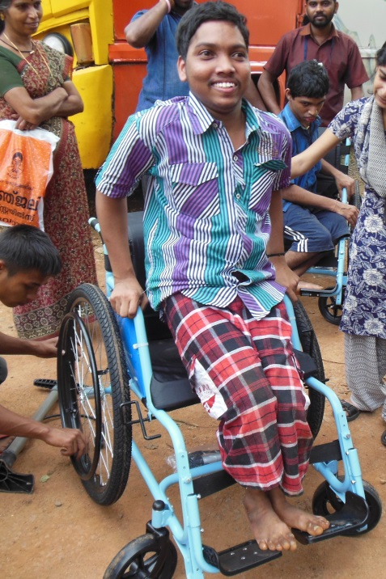
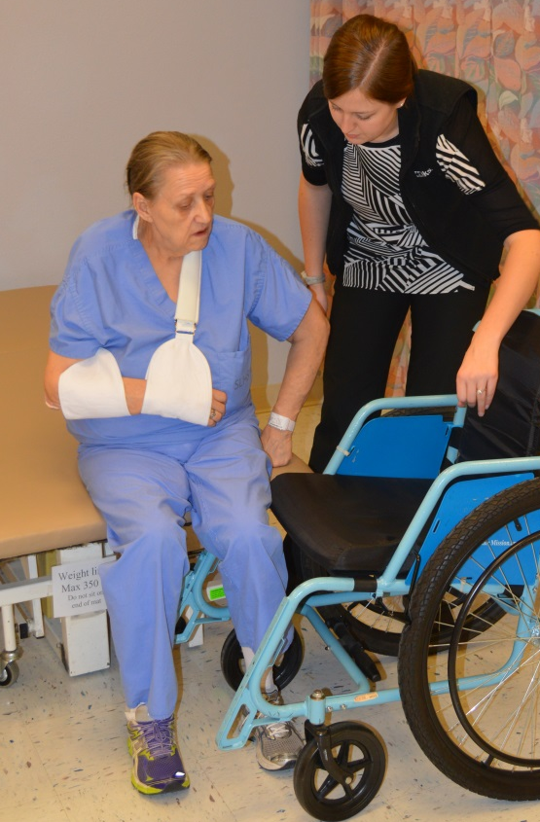
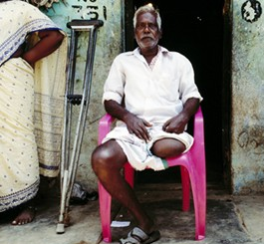
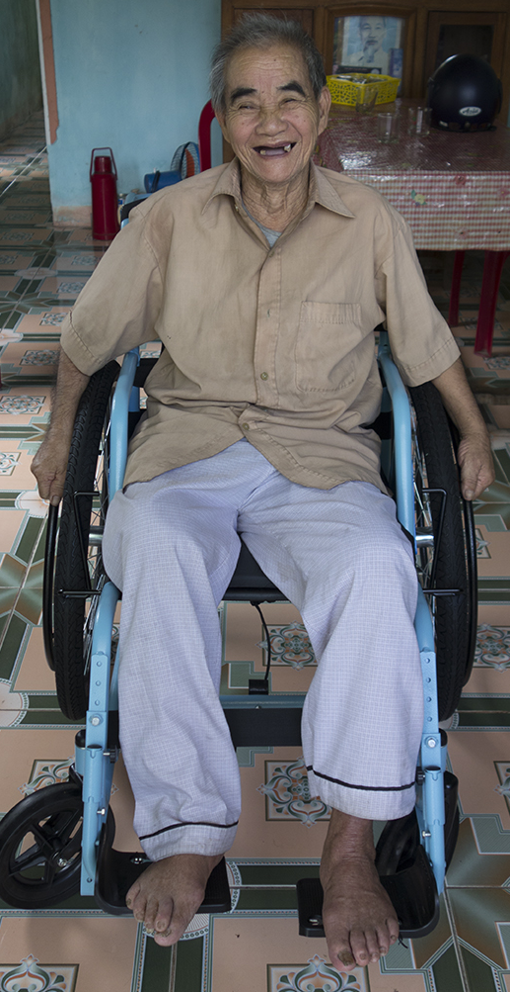
Diagnosis & Scenario

Slide 22
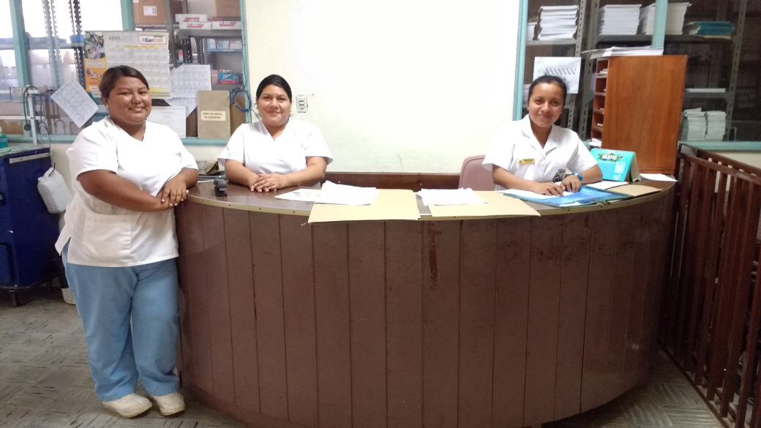
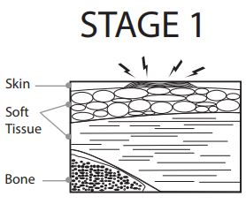
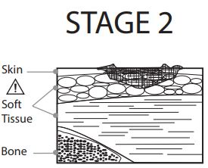
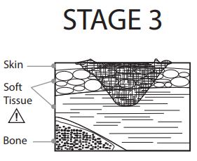
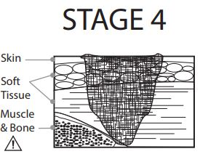
Pressure Sores
What are pressure sores?
  Sores caused by pressure, friction, or shear force
Refer to a medical professional if someone has a pressure sore.

Slide 23
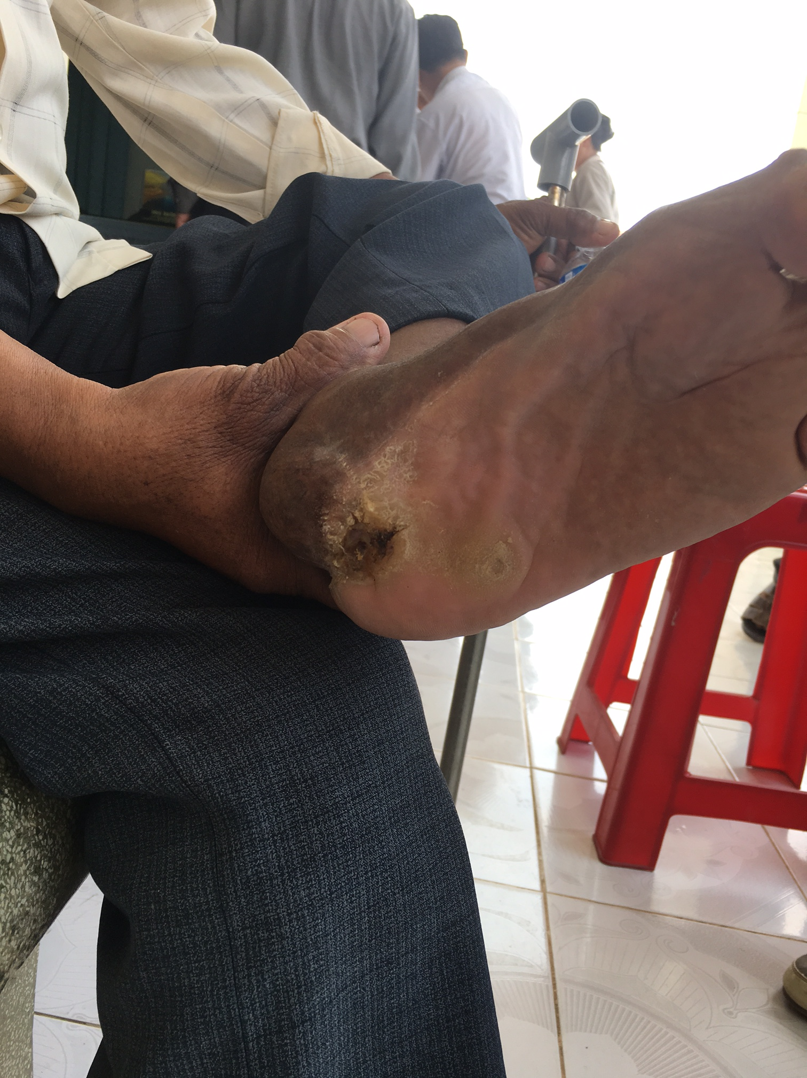
Pressure Sores (continued)
Common areas for people to get pressure sores.

Slide 24
1.4 Fit
Assessment, Prescription, Assembly, Adjustments

Slide 25
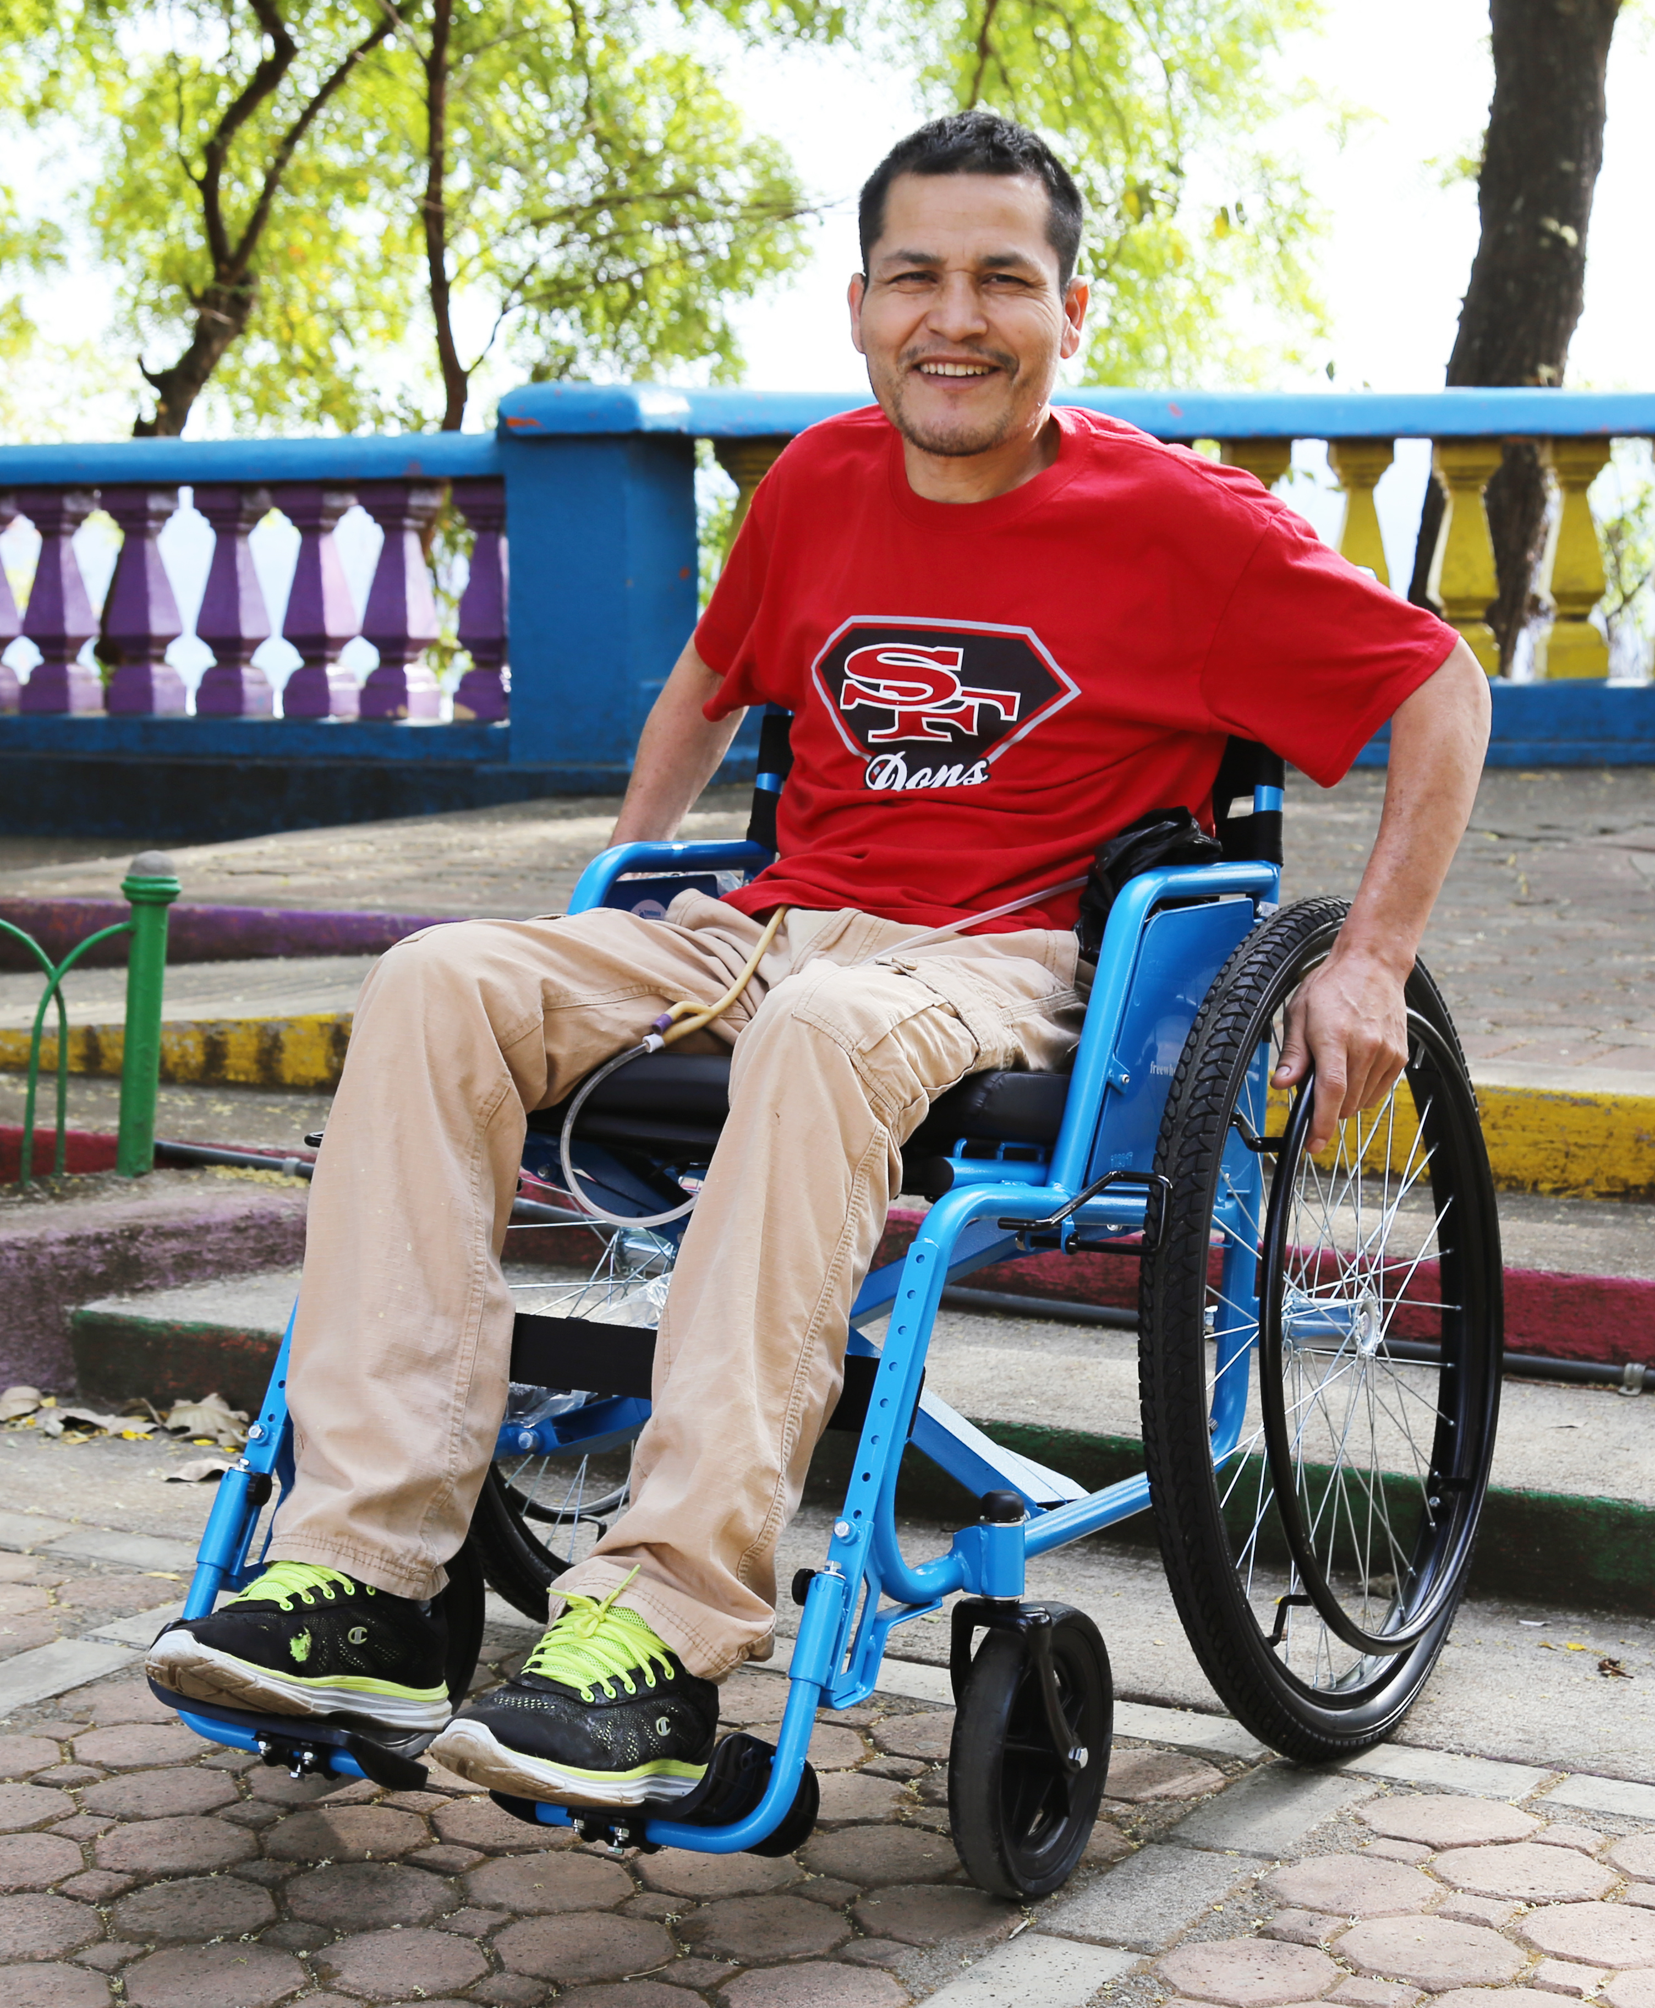
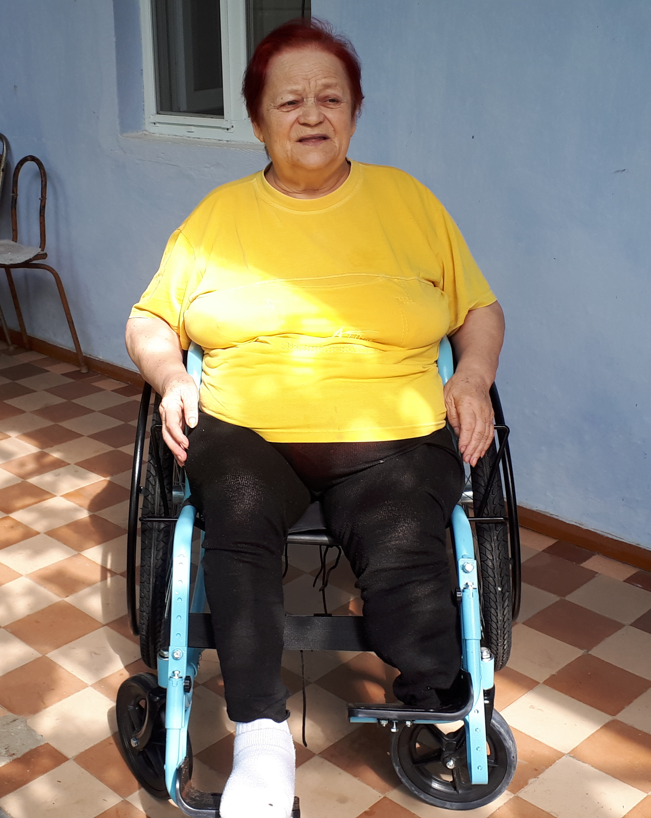
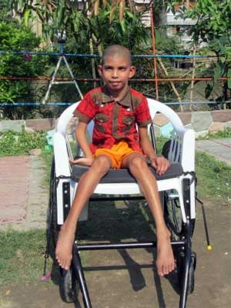
Overall Fit
WHEELCHAIR
TOO SMALL
WHEELCHAIR
TOO BIG
GOOD

Slide 26


Assessment: Set-Up
Set up your space
Get to know your client

Slide 27
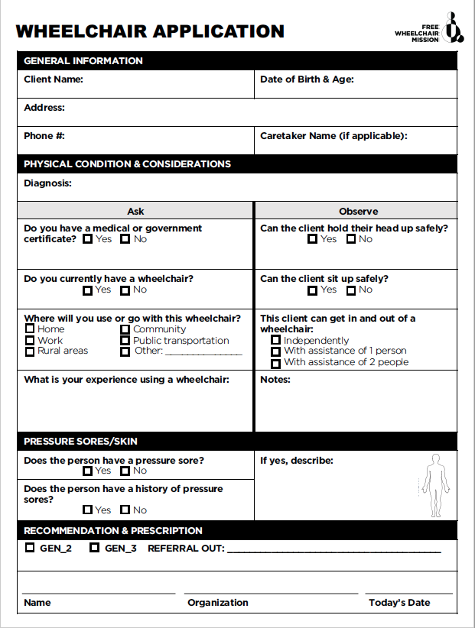
Assessment: Application
Application
  Questions to ask
    General Information
    Pressure sore/Skin Information
    Diagnosis
    Experience
  Skills to observe
    Transfers
    Movement
    Ability to sit upright
  Recommendations

Slide 28
Assessment: Measurement

Slide 29
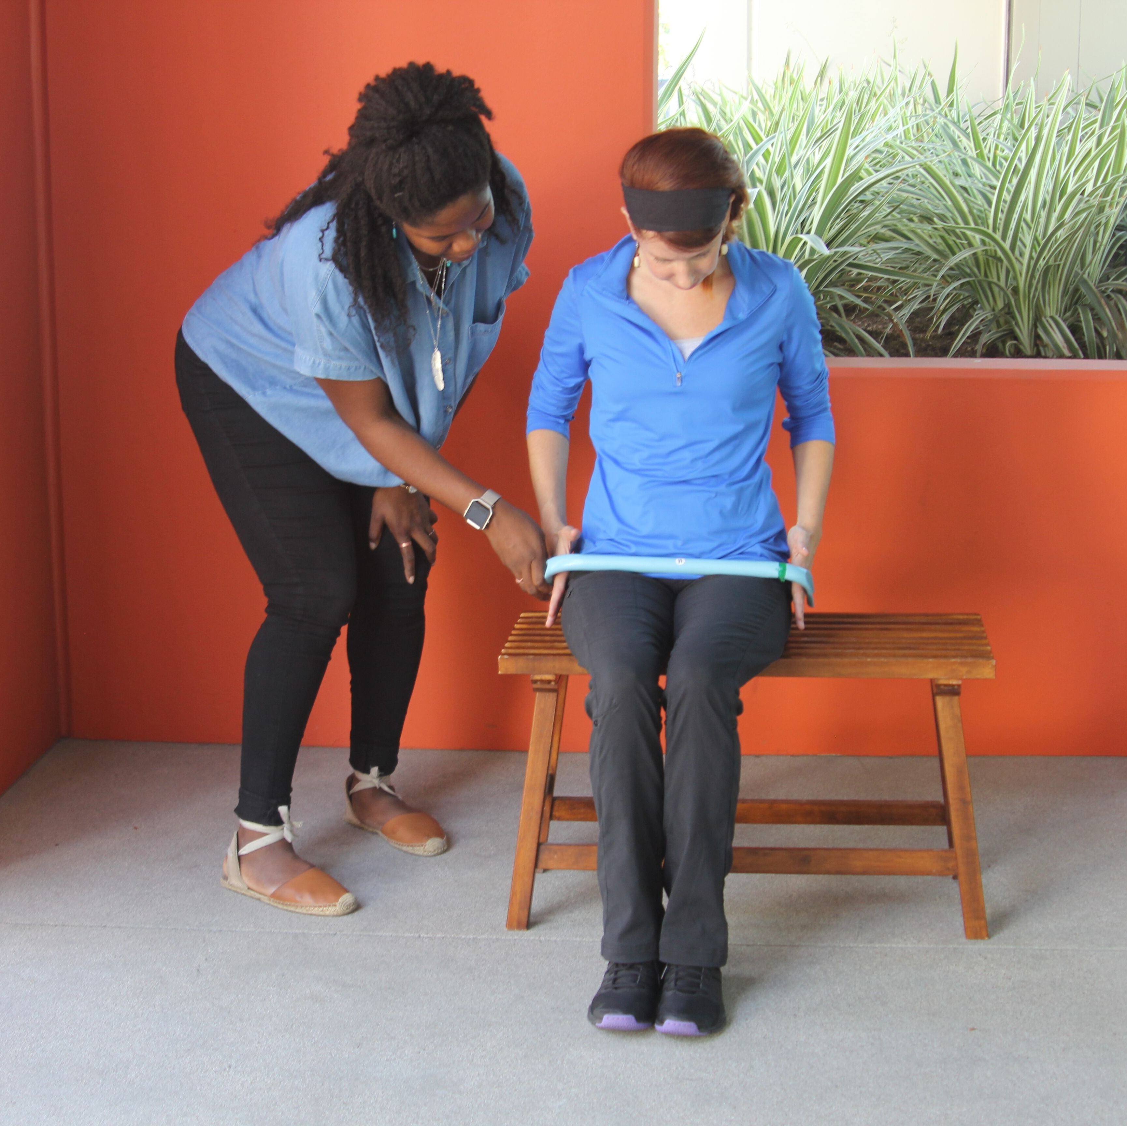
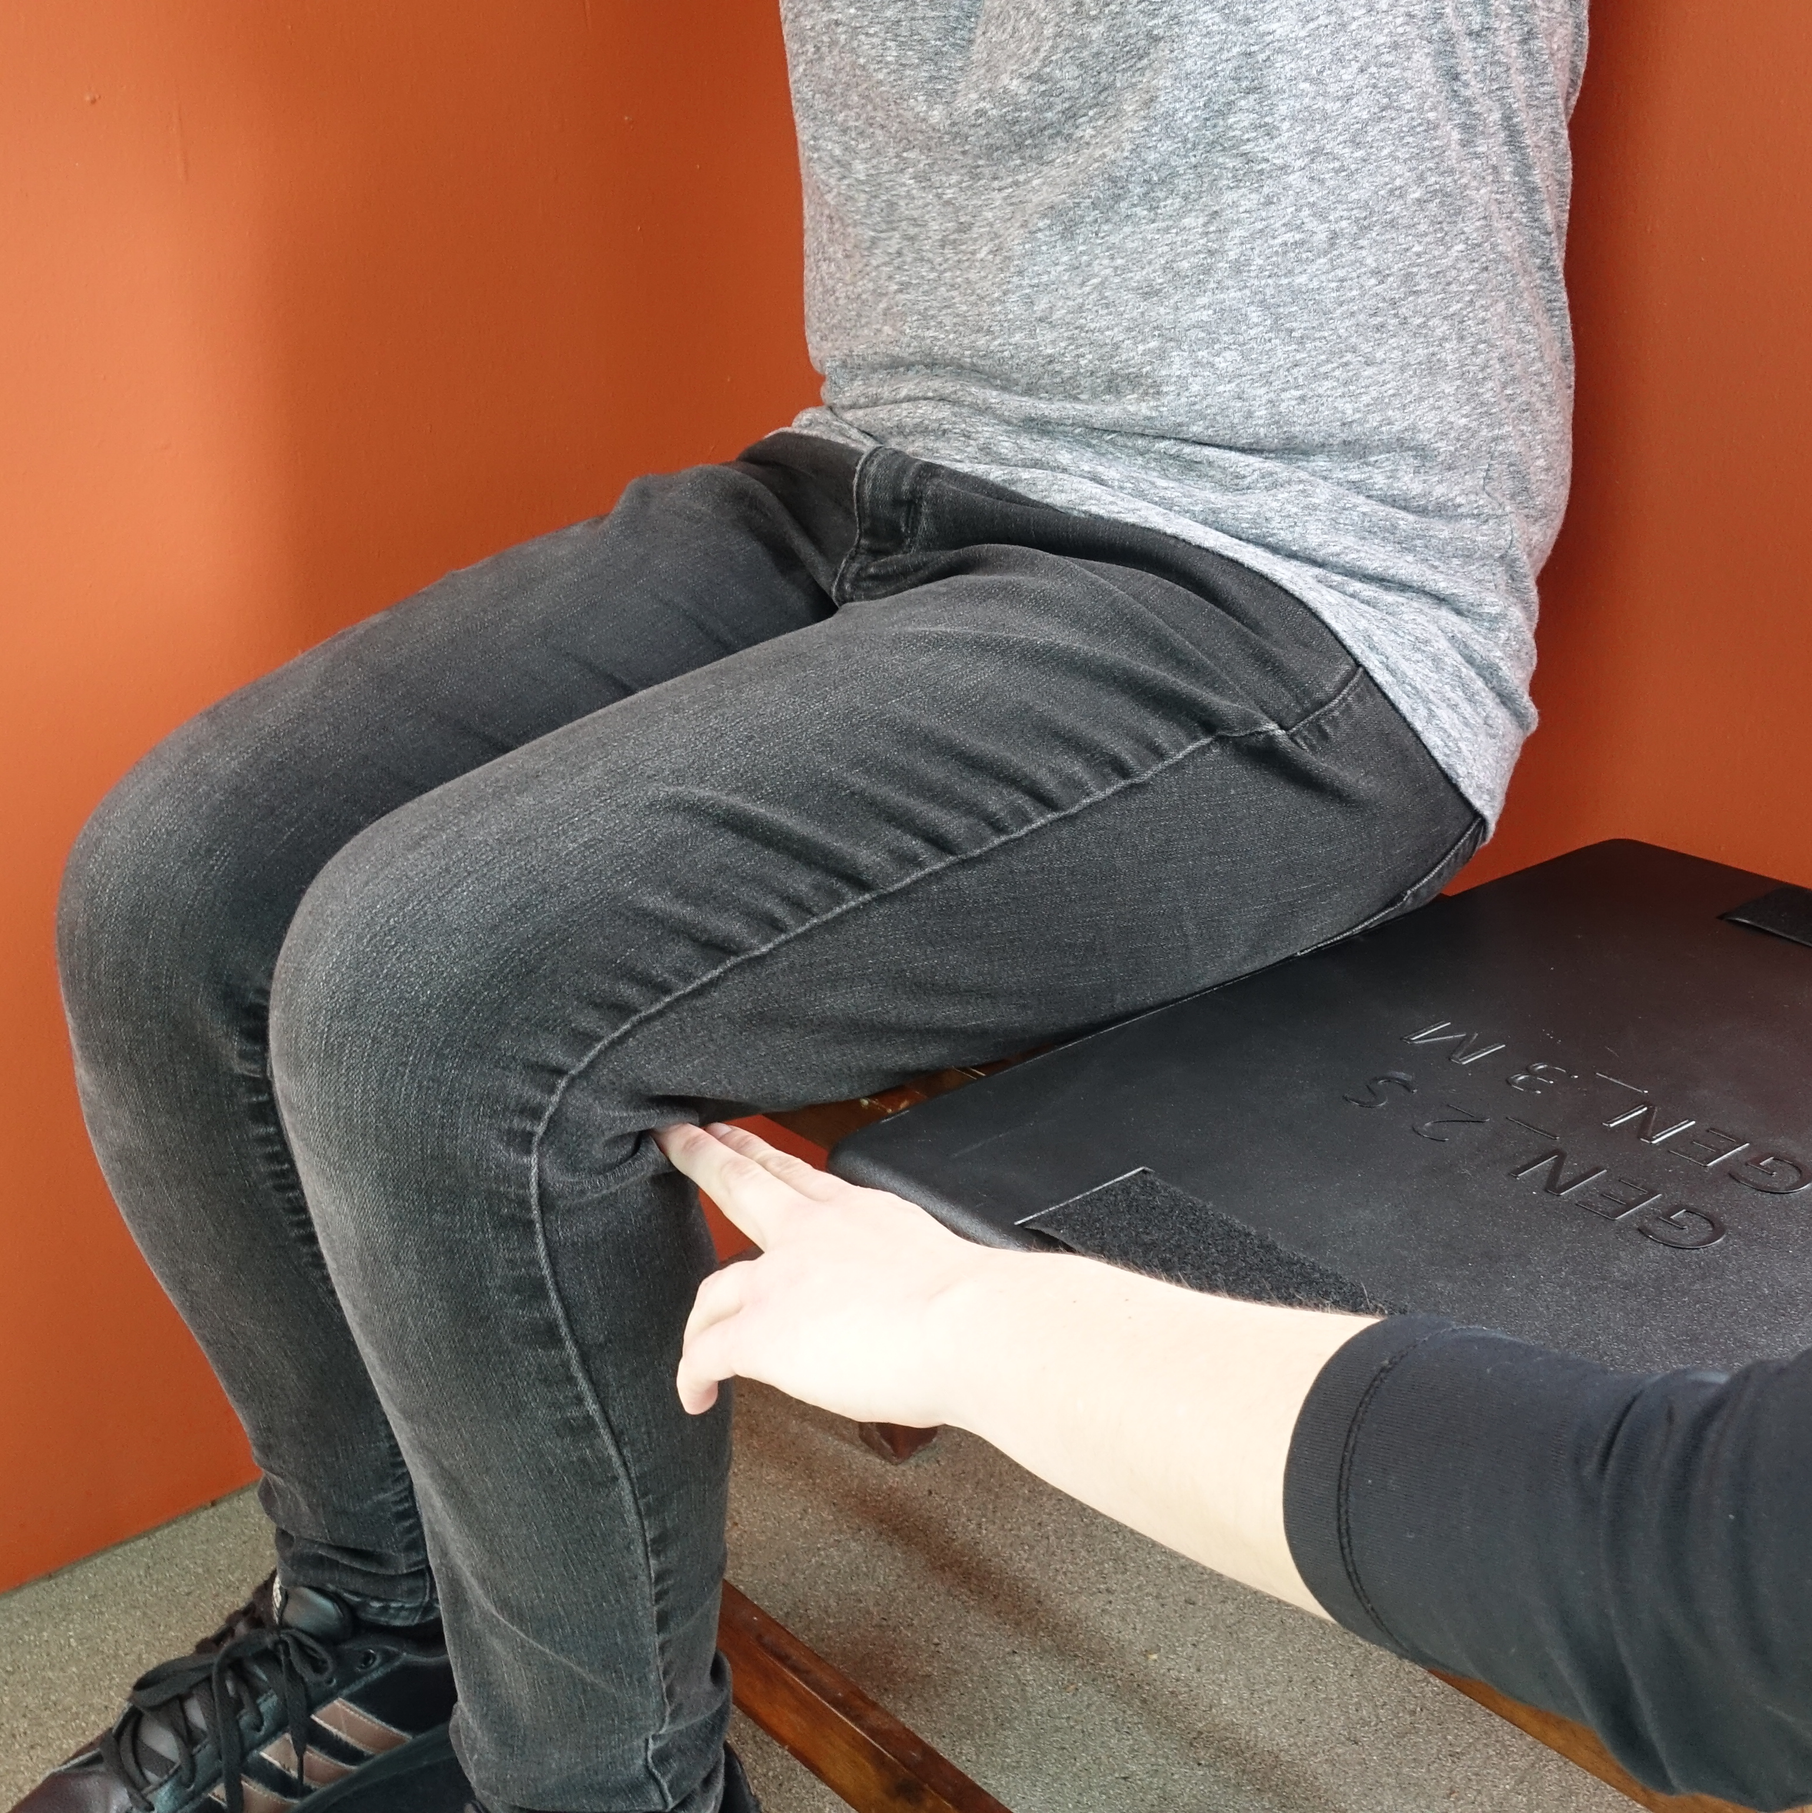

Assessment: Easy Measurement

Slide 30
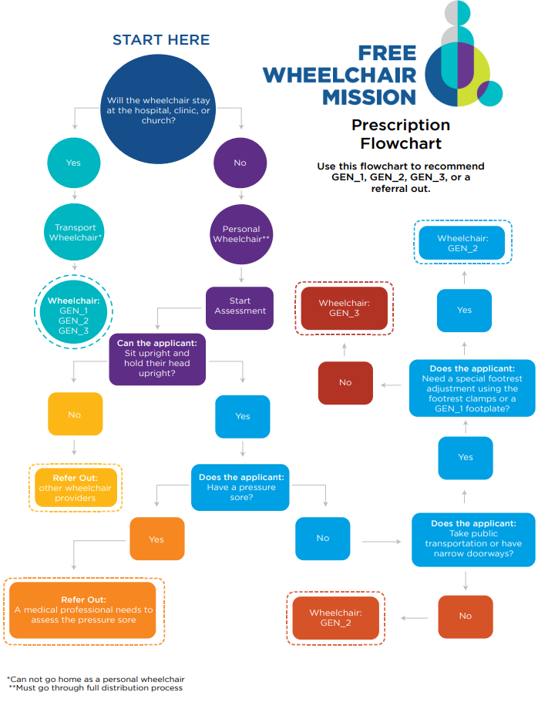
Prescription
Look at the application and the measurements to make a recommendation:
  GEN_1
  GEN_2
  GEN_3
  Refer Out

Slide 31

Referring Out
If someone needs a different kind of wheelchair, device, or service.
  Client has a pressure sore
    Check by medical professional
  FWM wheelchair is too big/too small
  Can not hold their body up safely
  Can not hold their head up safely
  Need a different mobility aid or service
Notes:
Picture of medical professional and other resources

Slide 32
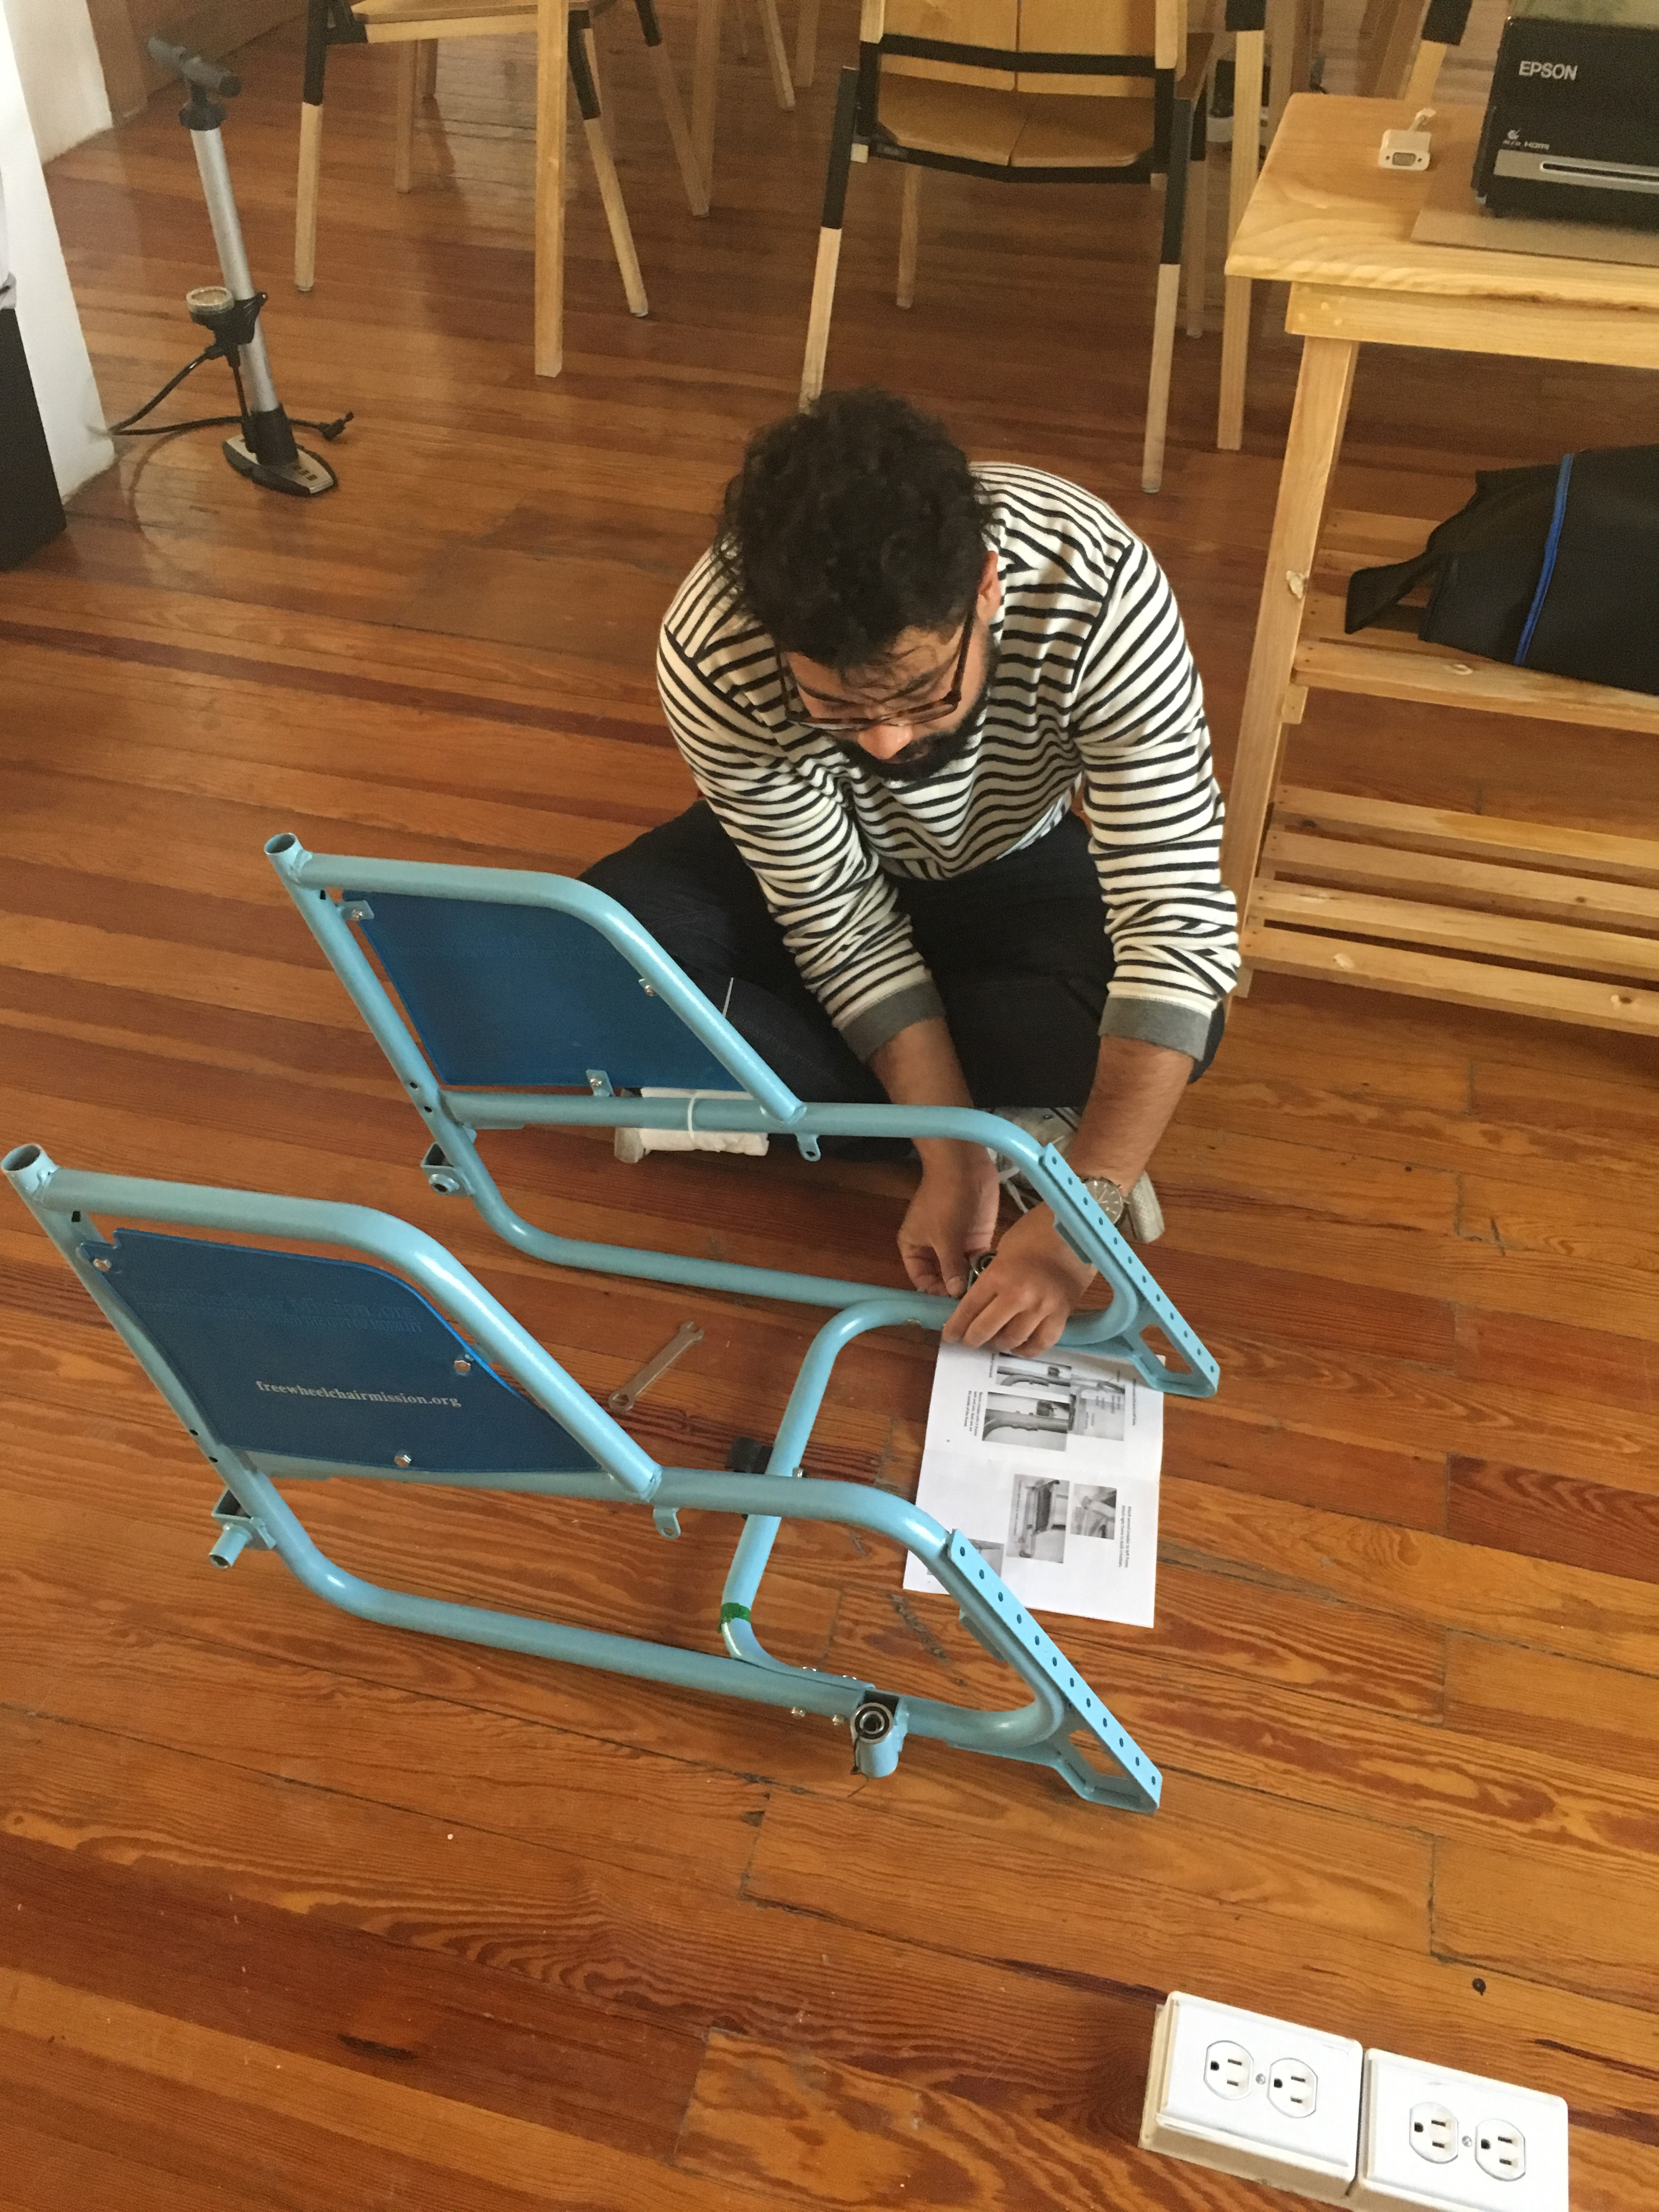
Assembly
Easiest way to assemble FWM wheelchairs
  Frame
  Seat with the cushion
  Backrest
  All wheels
  Brakes
  Seat belt, calf strap, etc.
Notes:
Frame of gen_3? Picture

Slide 33
Assembly Resources
Assembly Resources
GEN_3
GEN_2
GEN_1
Tying Knots
Assembly Posters
Pumping Tires
Assembly Step-by-Step
Assembly and Adjustment Documents

Slide 34





Adjustments
GEN_2 Seat Length
Short Middle Long
GEN_3 Seat Length
GEN_2 Backrest
GEN_3 Backrest
Footplate
Flipped Footrests
Up/Down Track
Footrest Clamps
Footrest Tilt

Slide 35
1.5 User Training

Slide 36

User Manual
Provide User Manual
  Located in the box

Slide 37

Pressure Relief Exercises & Education
4 Exercises
  Every 15 minutes for a length of 1 minute
Check body at night
Increase time sitting slowly
Stretch out

Slide 38
Transfers
Independent
1-person assisted transfer
2-person assisted transfer
Fall Recovery

Slide 39
Safety
Brakes
Fall Recovery
Open/Close GEN_3

Slide 40
Mobility Skills
Moving Forward/ Backward
Up Slopes
Up Curbs
Up Stairs
Turning
Down Slopes
Down Curbs
Down Stairs

Slide 41
Maintenance
Tighten bolts
Pump tires
Clean frame (with oil)

Slide 42
The Message
The Message
“We share this message on behalf of your friends at Free Wheelchair Mission:
Jesus Christ loves you. That’s why you are receiving this wheelchair. We believe that this wheelchair comes from God. He created you and He loves you as His child, just as you are.
As believers in Jesus, we are called upon to serve others. Our prayer is that as you move around, you too will trust Him, serve Him, and bring glory to His name.
God bless you.”

Slide 43
1.6 Follow-up

Slide 44
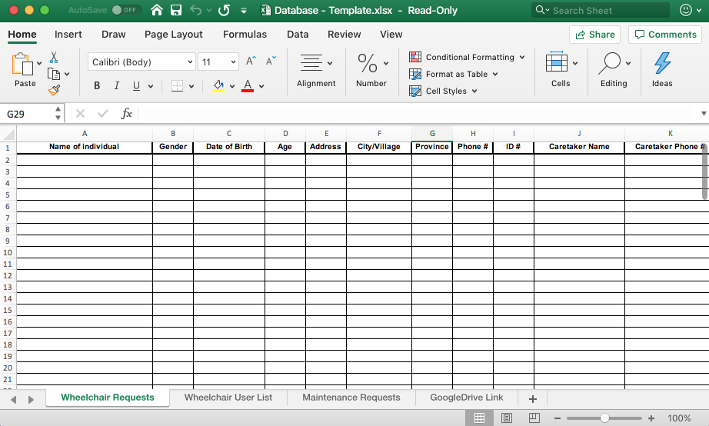
Database & Referrals

Slide 45
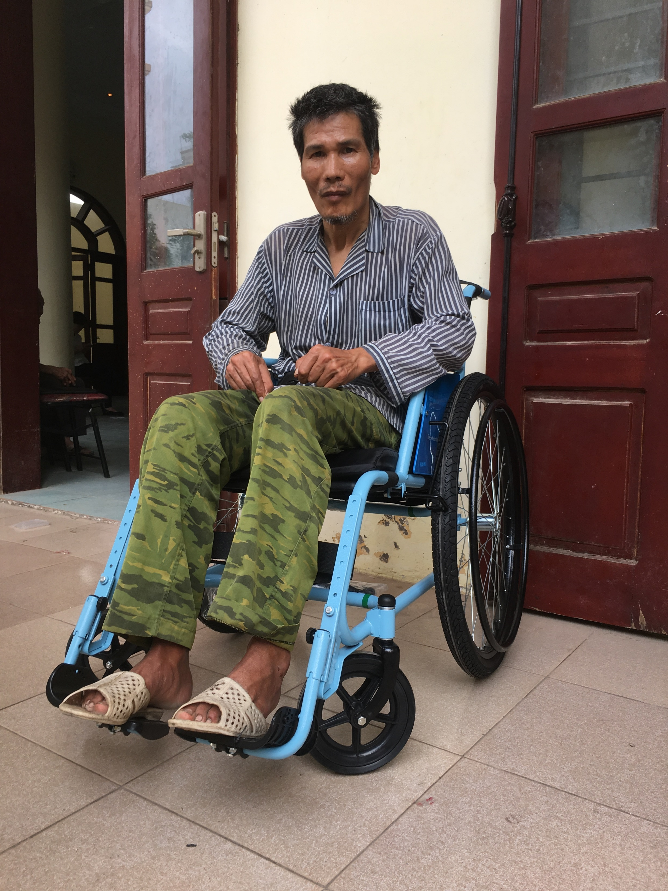
Reporting
Container Report
  Pictures
  Story
  Database information
Survey
  Your network
Communication
  Updates on staffing
  Successes & Challenges
  Social Media

Slide 46
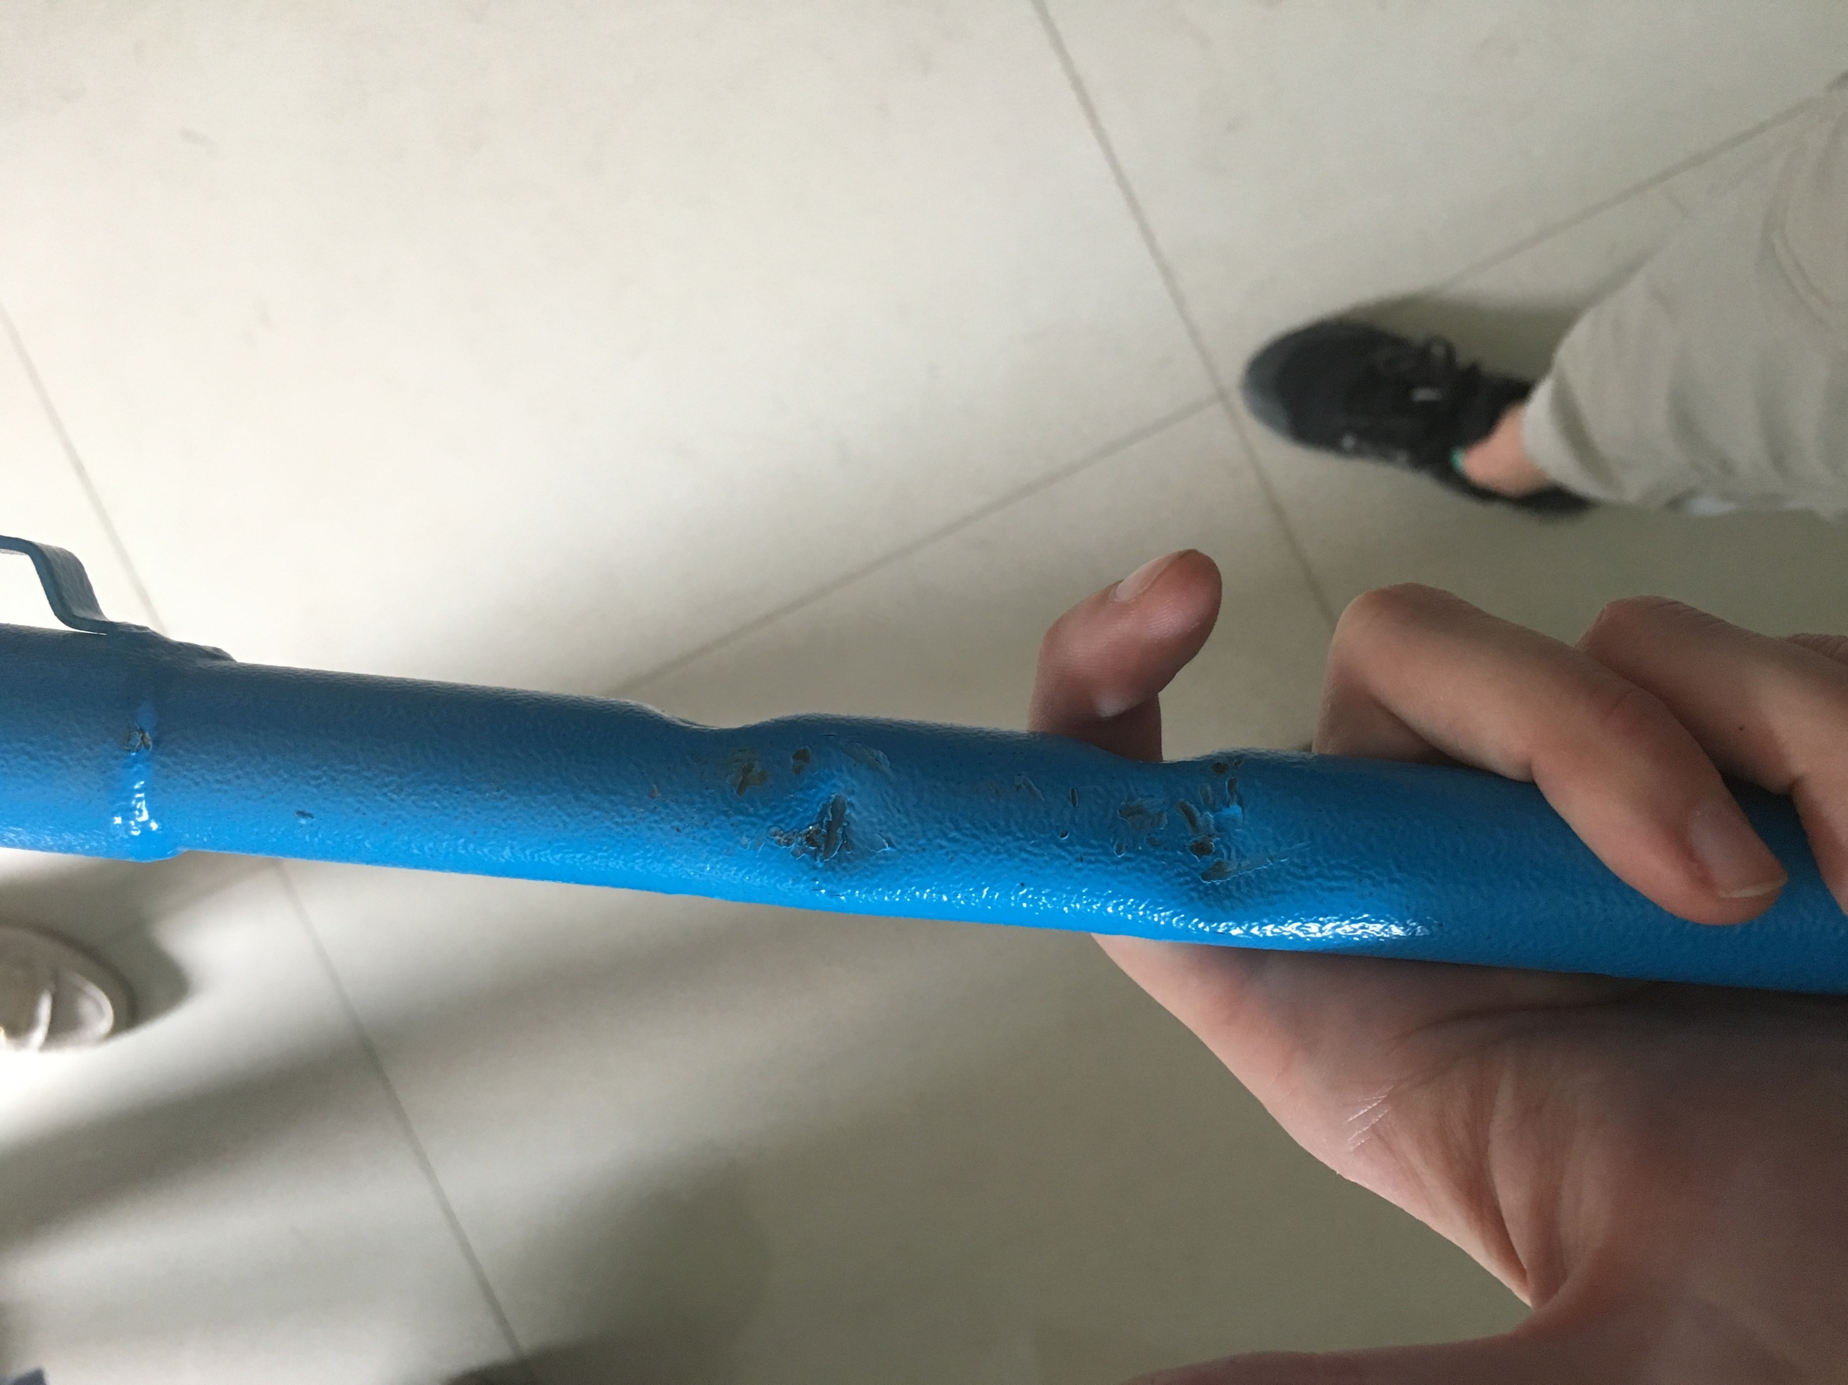
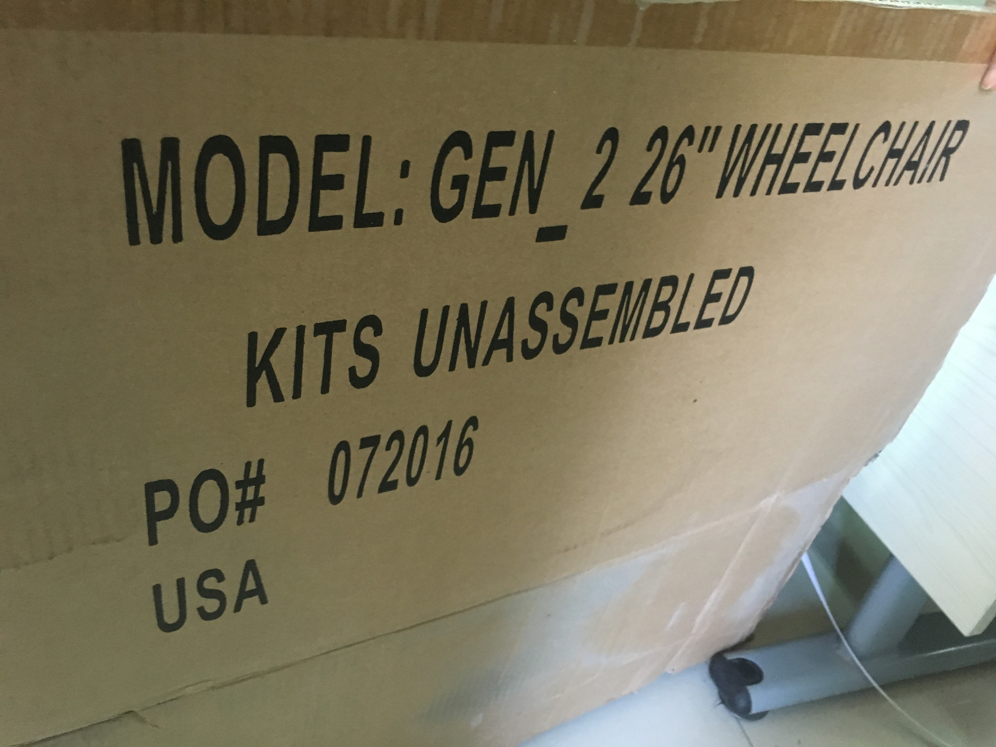
Quality Control (QC)
Quality Control Form OR Text WhatsApp #:
+1 (323) 996-9198
  Picture
  PO #
  How times you saw the issue
5/10 GEN_2s on May 20, 2019

Slide 47
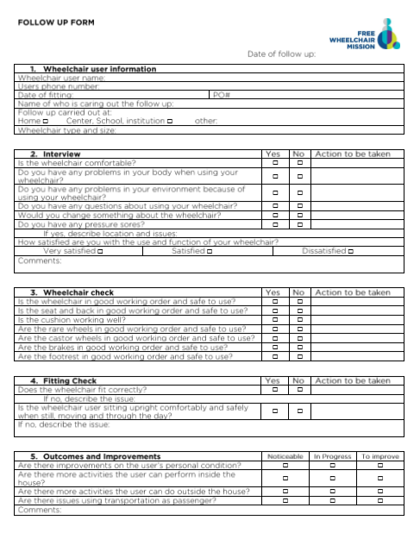
Follow-up
Follow-up with:
Clients/Wheelchair Users
Free Wheelchair Mission

Slide 48
Finished!

Slide 49
References
Best, K. L., Kirby, L. Smith, C. MacLeod, D. (2005). Wheelchair skills training for community-based manual wheelchair users: A randomized controlled trial. Arch Phys Med Rehabil Vol 86 2316-2323
ISWP - Seating and Mobility Access Toolkit (SMART). (n.d.). Retrieved June 21, 2019, from http://smart.wheelchairnetwork.org/
National Database of Nursing Quality Indicators. (n.d.). Pressure Injuries and Staging. Retrieved June 21, 2019, from https://members.nursingquality.org/NDNQIPressureUlcerTraining/Module1/Default.aspx
Shore, S. & Juillerat, S. (2012). The impact of a low-cost wheelchair on the quality of life of the disabled in the developing world. Med Sci Monit 18(9), CR533-542
Toro, M.L., Eke, C., & Pearlman, J. (2016). The impact of the World Health Organization 8-steps in wheelchair service provision in wheelchair users in a less resourced setting: a cohort study in Indonesia. BMC Health Services Research 16:26
UN General Assembly, Convention on the Rights of Persons with Disabilities : resolution / adopted by the General Assembly, 24 January 2007, A/RES/61/106, available at: https://www.refworld.org/docid/45f973632.html [accessed 23 February 2019]
Werner, D. (2009). Disabled Village Children. Berkeley, CA: The Hesperian Foundation.
World Health Organization. (2008). Guidelines on the provision of wheelchairs in less resourced settings. Retrieved from http://www.who.int/disabilities/publications/technology/wheelchairguidelines/en/
World Health Organization. (2012). Wheelchair service training package — Basic level. Retrieved from
http://www.who.int/disabilities/technology/wheelchairpackage/en/
Zollars, J.A. (2010). Special Seating: An Illustrated Guide Revised Edition. Albuquerque, NM: Prickly Pear Publications.

Slide 50


Additional Resources
You can find all of our resources on the partner website:
https://www.freewheelchairmission.org/dp-home
Password: GEN_123
Please join our Facebook group:
www.facebook.com/groups/FWMdistributionpartners
For information about other wheelchairs or training you can go to:

